Slide 1
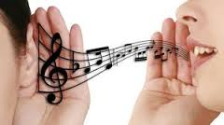
Phonetics 2

Slide 2
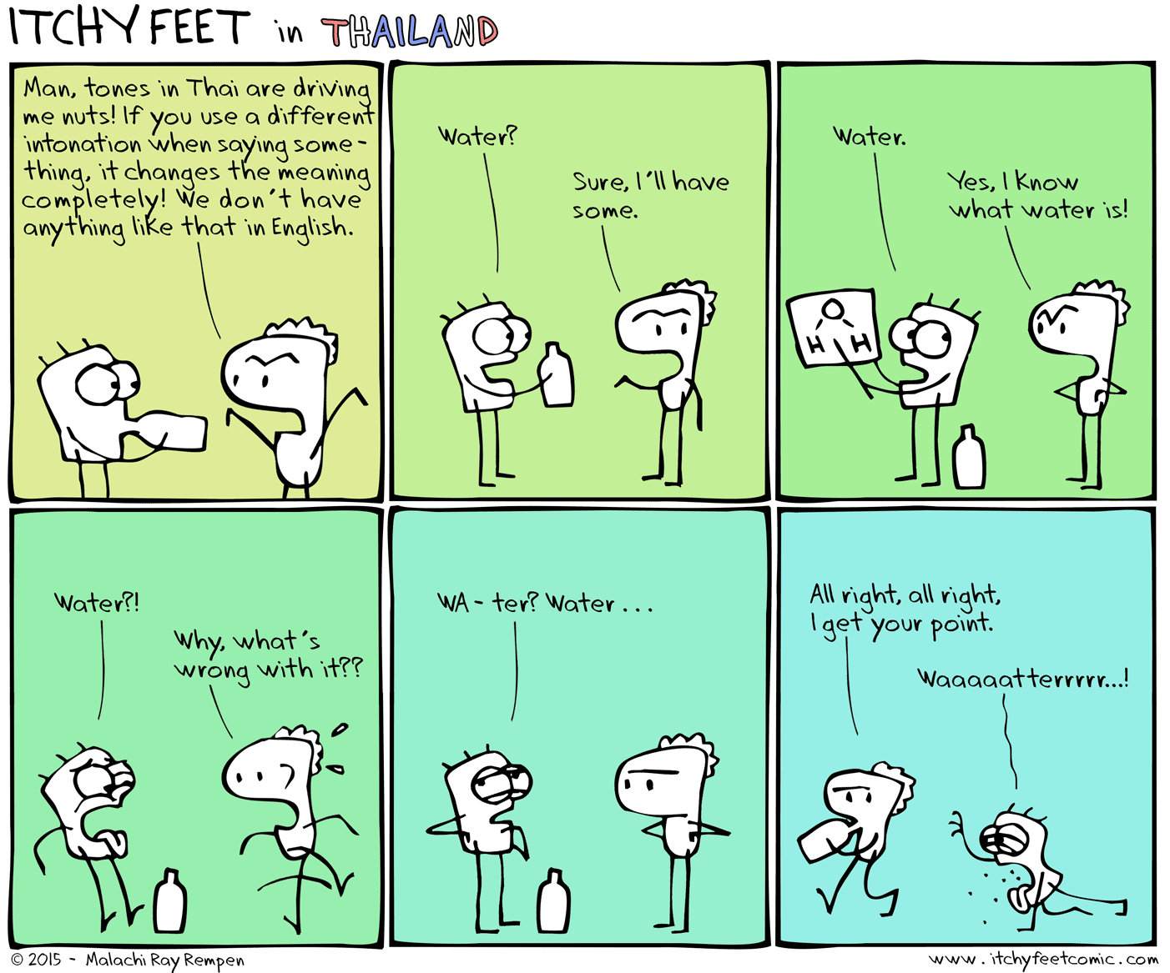

Slide 3
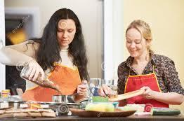
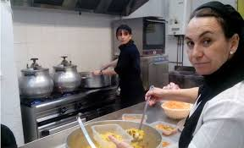
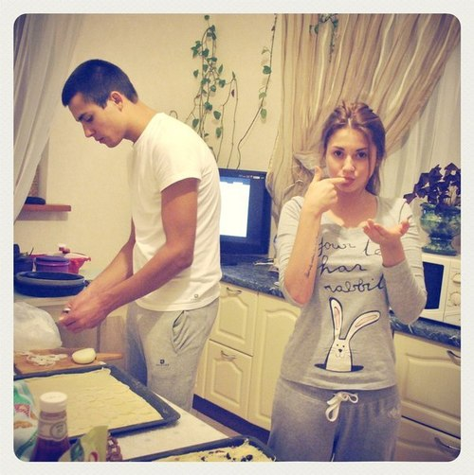
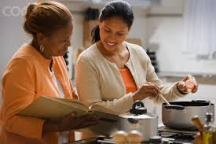
1. A friend in her 1st visit
2. A close
friend
3. A couple
4. A foreign visitor

Slide 4
Watch the following scene from The King of Queens and answer the questions below:
What pizza place doesn’t Arthur like?
Underline the stressed syllable in the following word uttered by Arthur: DOMINOS
Write down the phone number for the pizza place
https://www.youtube.com/watch?v=RW7iB2iOTKw

Slide 5
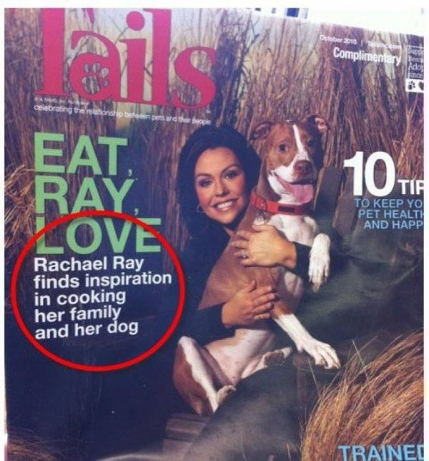

Slide 6
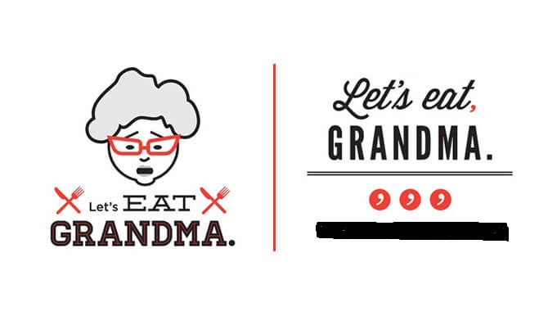

Slide 7
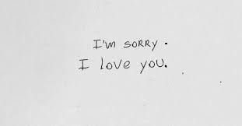
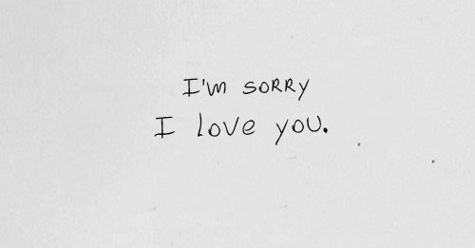

Slide 8
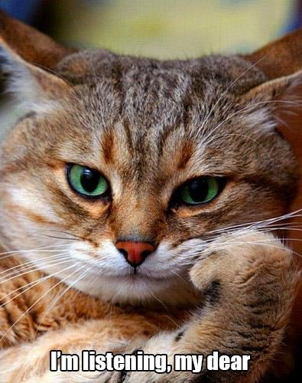
1. What are you doing?

Slide 9
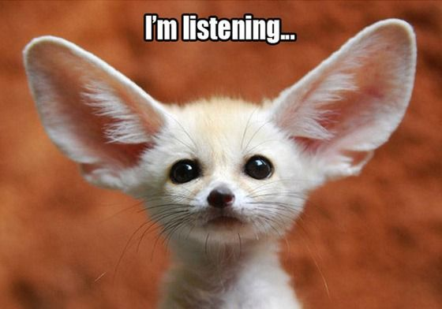
Who’s listening?

Slide 10
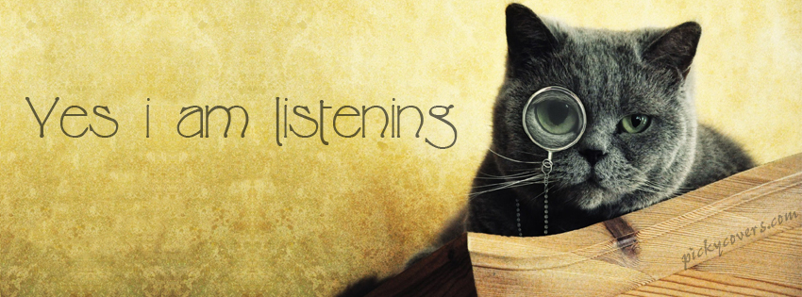
You’re not listening!

Slide 11


Slide 12
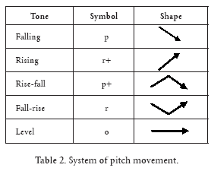

Slide 13
Videos 1 & 3 | Rachel: I’m still in love with you Ross Ross: Wow
Video 2 | Rachel: what you’re reading? What’s it about? Ross: The events around the world.
Video 4 | Chandler: She’s still upset because I saw her boobies It was an accident. It’s not that I was across the street with a telescope and a box of donuts
Video 5 | Janice: Oh my god

Slide 14
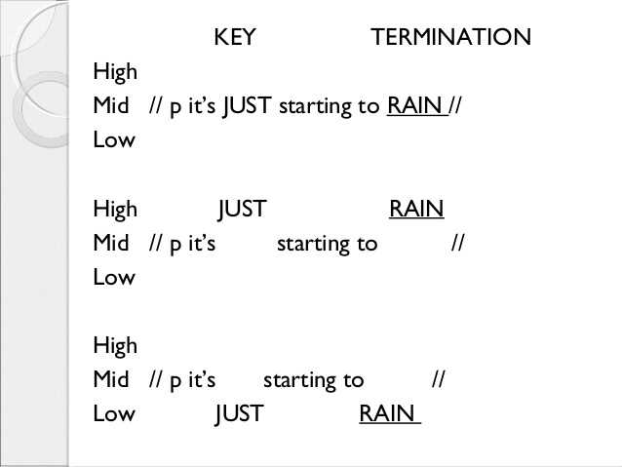

Slide 15
Video 6 | Joey: I don´t know what to do or say. I don’t know what to do
Video 7 | Yes. Although I think we might be seeing too much of some people. Aren’t you a bit old to be wearing a dress like that?

Slide 16


