Slide 1

Interpretación:
Práctico 7
Prof. María Julia Pich
Notes:
.

Slide 2
Public speaking
The author is rather blunt but do not take his words to mean there’s nothing you can do about how speaking in public makes you feel. After all, he writes a whole book about it!
Consecutive Interpreting by Andrew Gillies (page 25)
“If speaking in public makes you unhappy and/or unwell
then interpreting may not be the job for you.”
A word on nerves

Slide 3
Watch the following video
(Plus, check out the whole speech repository!)
If it makes you feel more confident, look up the following in advance:
benign audience, juncture, bedraggled, jaunty, shattered, the bar is low, unfeasibly, dud advice
After analyzing the paratext:
what do you expect? What words do you expect to hear? How many parts do you expect?

Slide 4
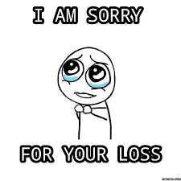
Free speech is really utopic…
Exhibit A: chatbots!
Context = virtual force generating language events to get things done

Slide 5
Let’s reflect
Reflect on the role of the interpreters. Compare them.
Reflect on the use of notes.
What does the shot itself tell you about the role of interpreters?
Compare the speakers.

Slide 6
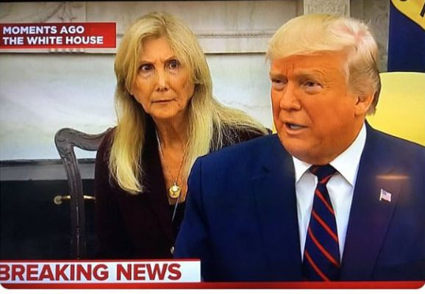
Click and Click

Slide 7
Don’t forget about first sight!
Always present!
Posters, subtitles, powerpoint presentations, documents handed over at the very last minute.
Don’t forget about short consecutive! (you may drop your notepad ;)

Slide 8

What can we do to prompt recall?
( Again! I know, last time, I promise)

Slide 9
• narrative prompts
• visual prompts
• structural prompts
• logical prompts (latent memory)

Slide 10
Yet, always have in mind that nothing can replace…
Attention
Interest
Comprehension
& what we already know!!!!!!

Slide 11

Logical prompts
either:
Work backwards
Answer questions

