Slide 1
Articulación con el teórico 1
Traducción vs. Interpretación
Iliescu Gheorghiu, C. (2001). Diferencias: traducción frente a interpretación. En Introducción a la interpretación. La modalidad consecutiva (pp. 22-27). San Vicente del Raspeig: Universidad de Alicante.

Slide 2
What should interpreters strive for?

Slide 3
Communicative equity is a right too!
Interpreting takes different shapes…

Slide 4


Slide 5
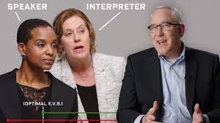
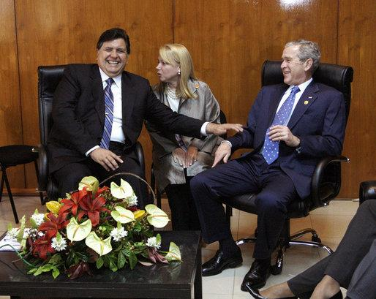
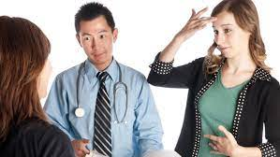
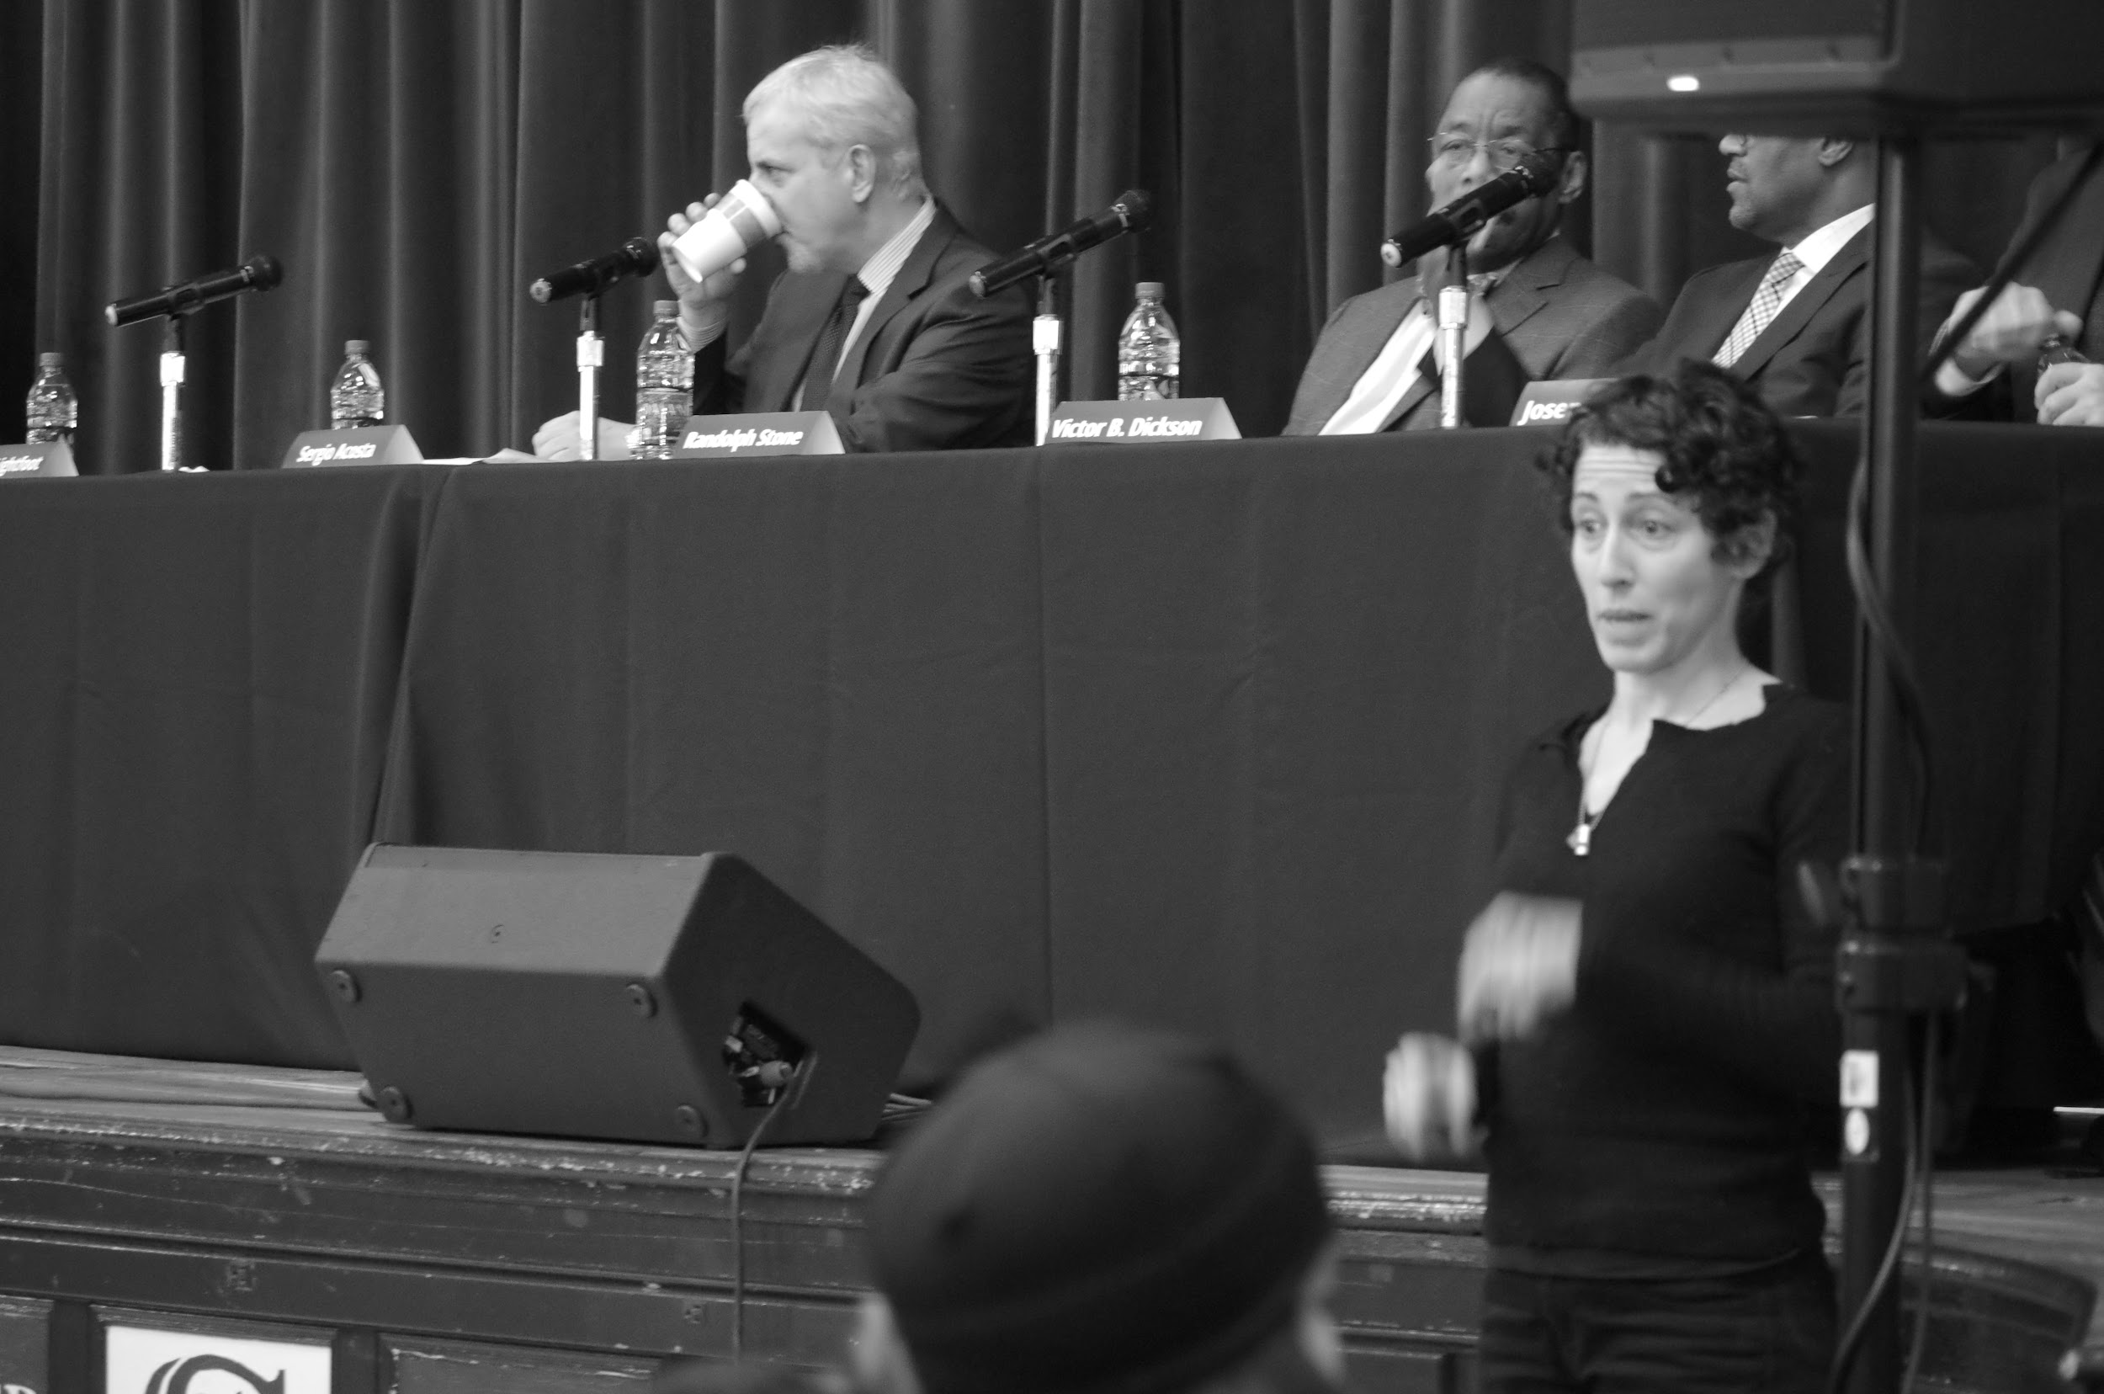
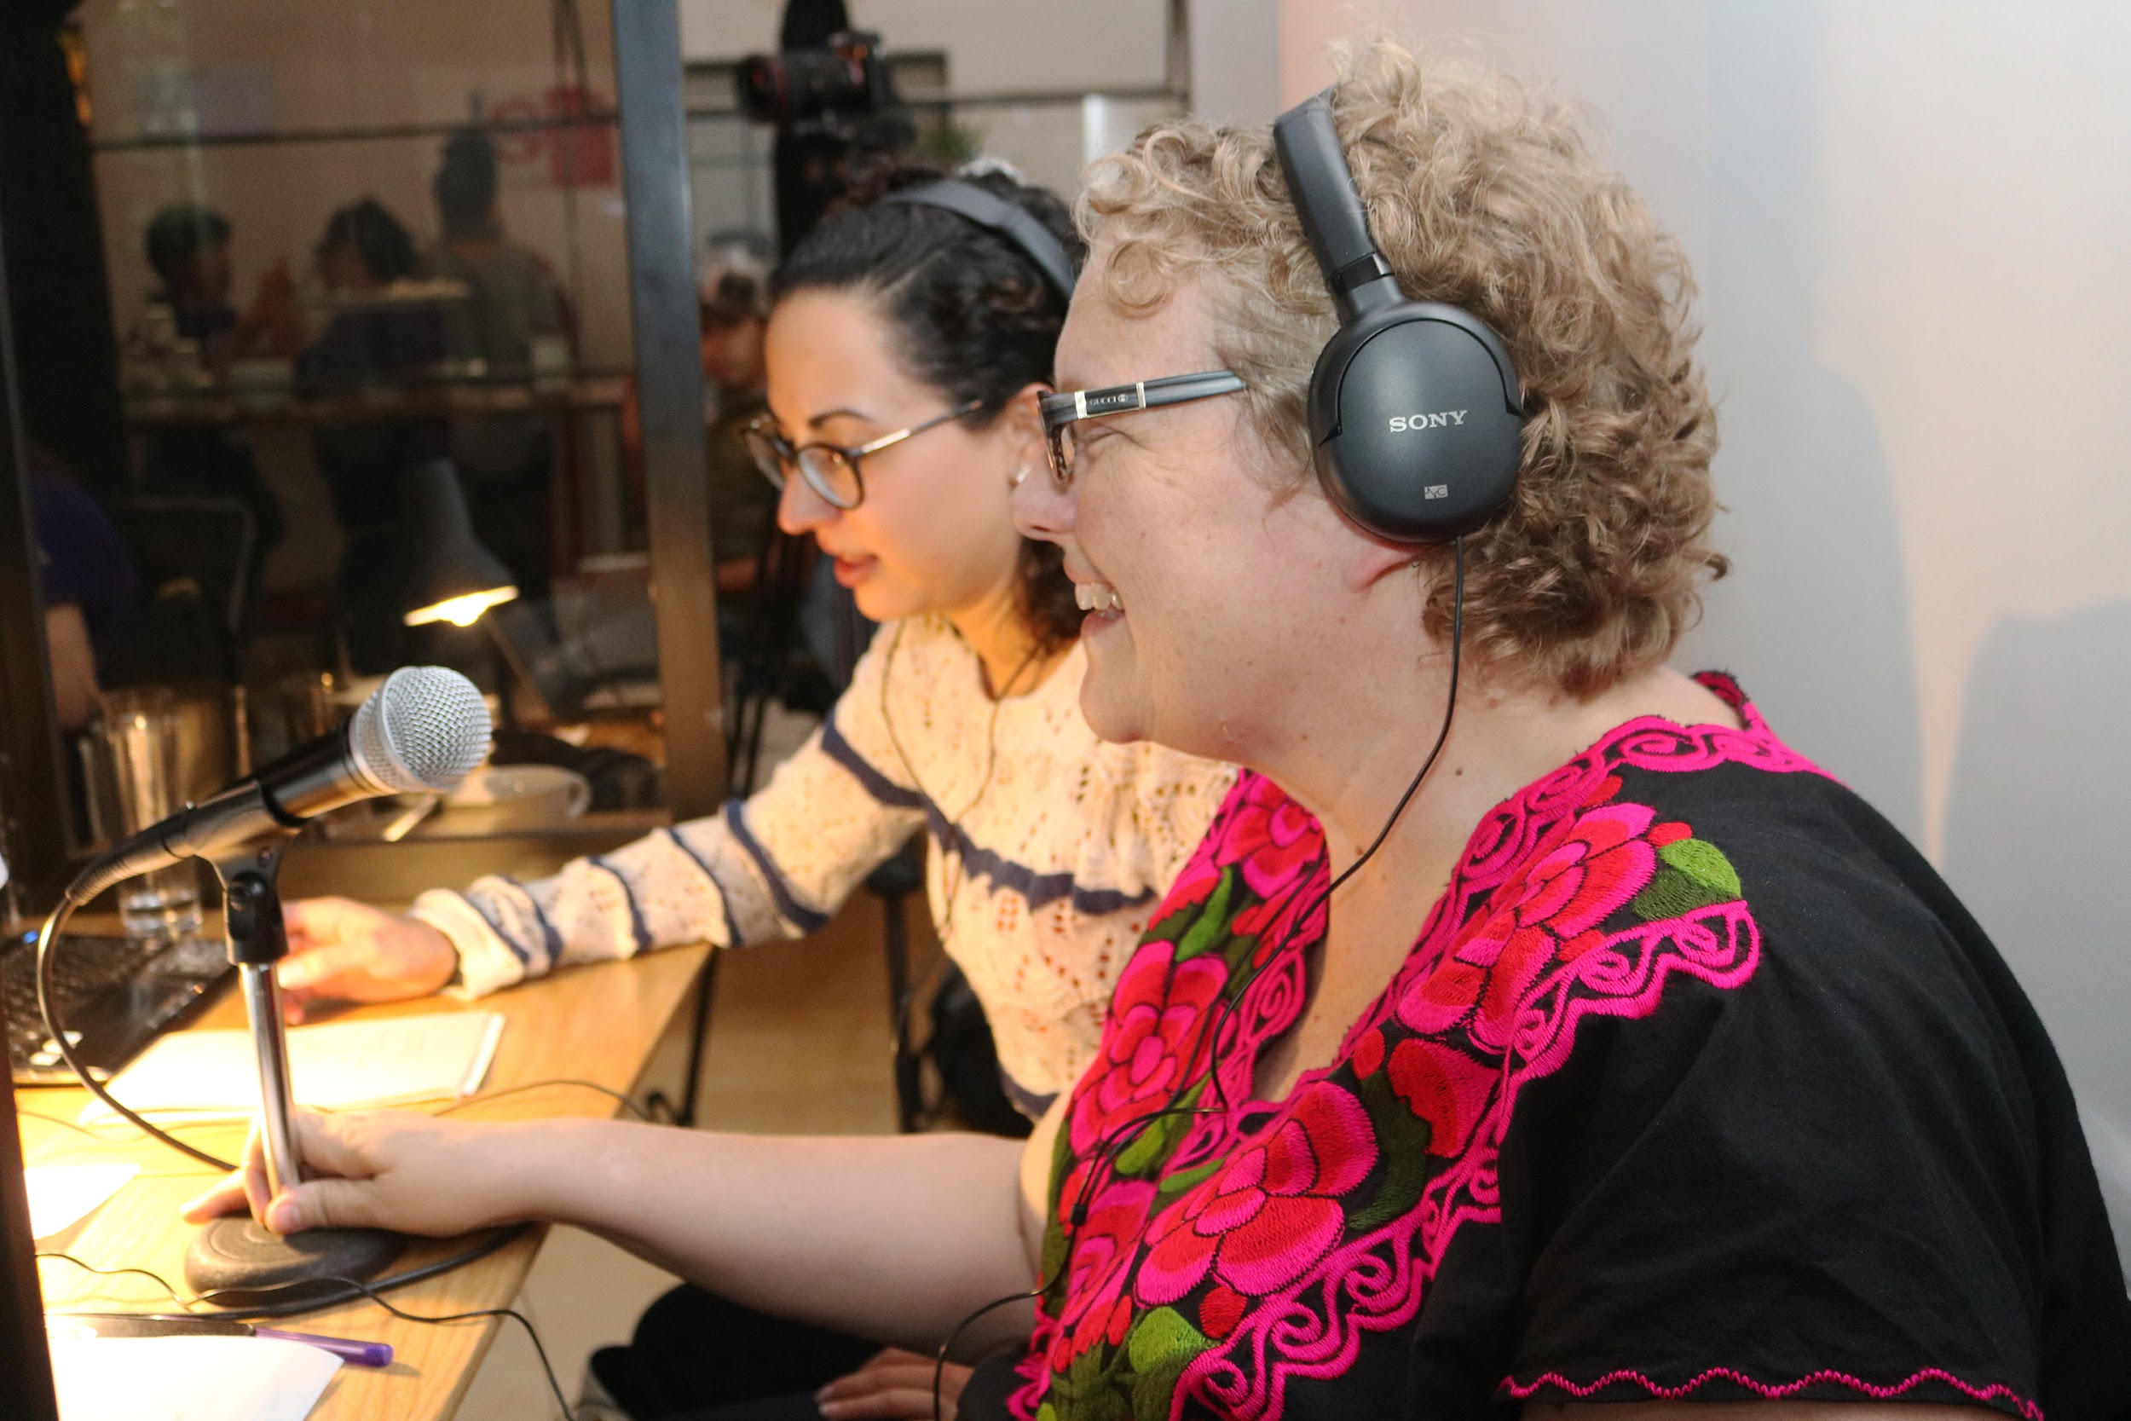

Slide 6
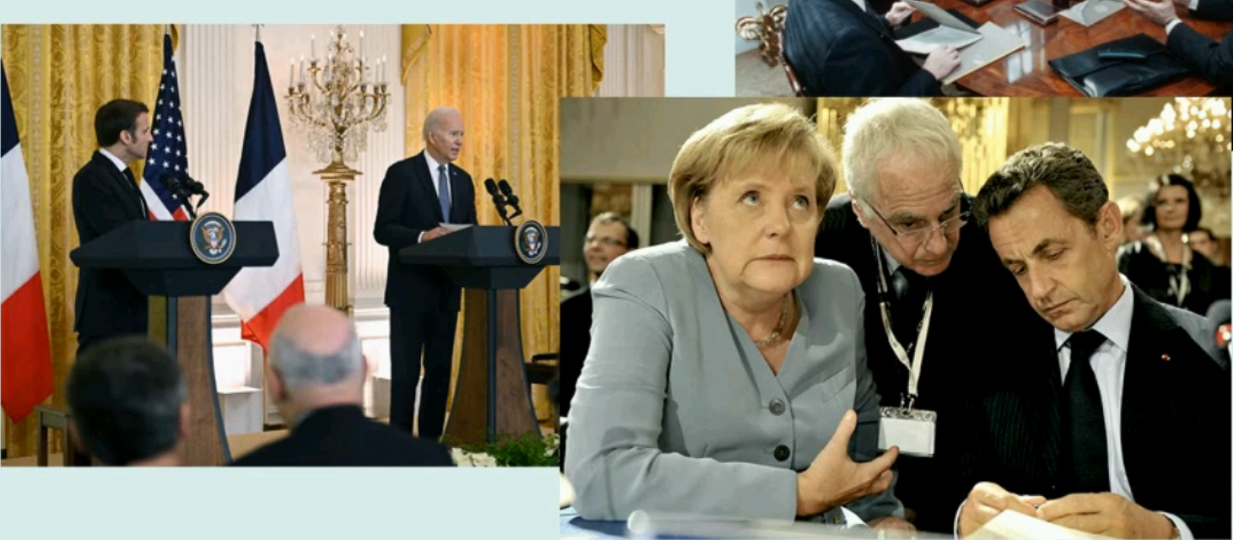

Slide 7
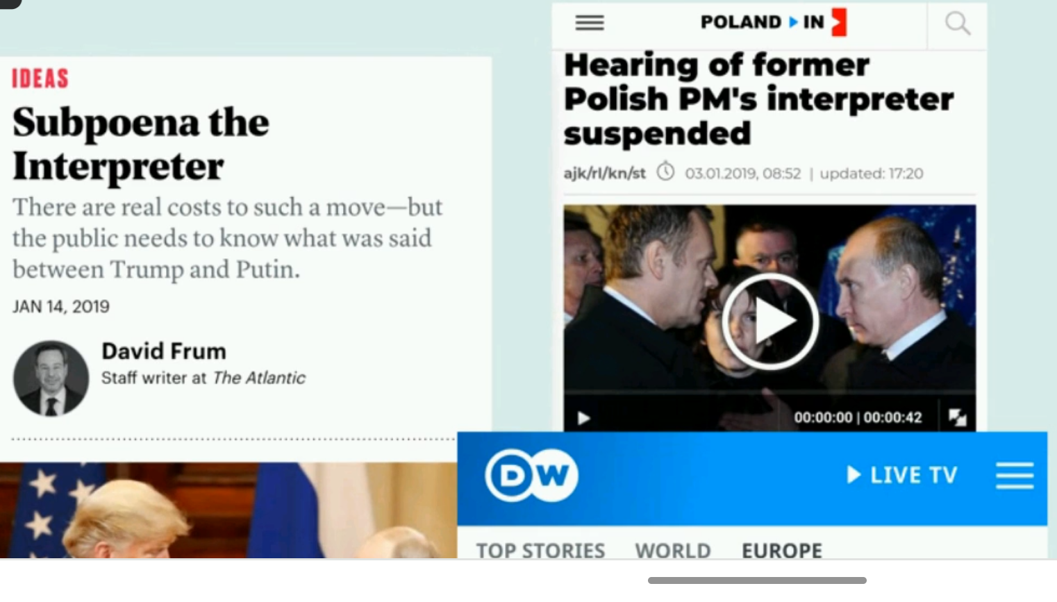

Slide 8
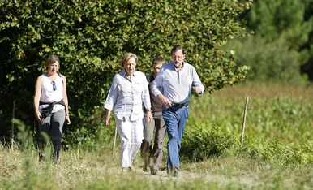
Typical setting? Always sitting down?

Slide 9
Watch

Slide 10
Do a bit of research
Winema Riddle
Malinche
Lydia Callis
Valentin Berezhkov
Thamsanqa Jantjie

Slide 11
First things first

Slide 12
First sight
“hybrid” why?
“important” why?
contexts?
“Easy” why? “difficult” why?
How do we practise? Can we be ready for any text?

Slide 13

Why is this so exhausting, teacher? Because it is! Plus, it shouldn’t show (don’t sigh, curse or otherwise show your exhaustion :)

Slide 14
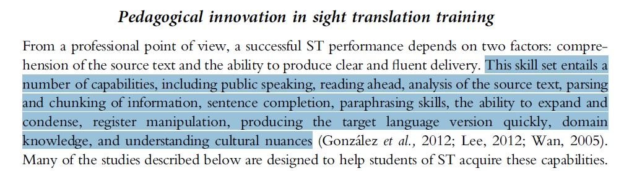

Slide 15
No wonder… You do all of this at once
public speaking
reading ahead
analysis of the source text
parsing and chunking
sentence completion
paraphrasing skills
ability to expand and condense
register manipulation
producing the target language version quickly
domain knowledge
understanding of cultural nuances

Slide 16
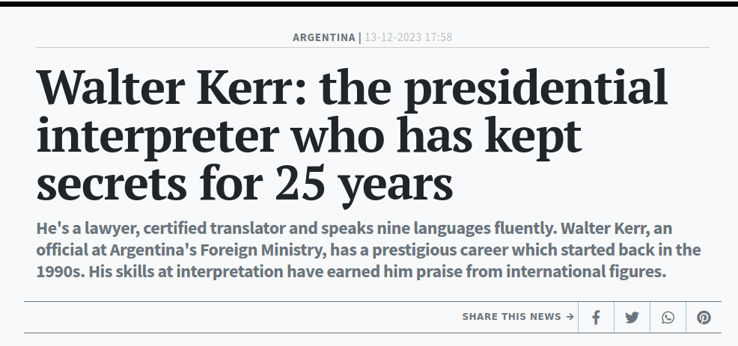

Slide 17
Get ready! Feel ready! Glossaries (contribute to our Glossary!) and keep working on your general knowledge (this week capitals of the world!)
Stretch your eye span
Avoid false friends. Ex: firm… firma? always?
Beware of fancy adjectives... Ex: long-term, large-scale, fast-track
oralization of texts and acronyms and abbreviations. Ex: Hay una foto, etc.
Notes:
Did you do the quiz about presidents? World organizations?

Slide 18
Beware of false friends

Slide 19
Let’s avoid false friends!
Play around with these quizlets:
going into English and going into Spanish!:
Keep your own false friends dictionary so you identify traps and avoid them.

Slide 20
Beware of acronyms!
Empecemos a pensarlos…
Sí o sí los tengo que reconocer. Si “no me sale” en la otra lengua es otro tema pero tengo que tener una vaga idea al menos para poder decidir qué hacer.
Ex: las PASO.
Con saber que son elecciones seguramente alcanza!

Slide 21
 | Spell it out | In Spanish? | ¿Qué significa?
EU | European Union
UNHCR | United Nations High commissioner UN refugee agency | ACNUR | Alto comisionado…
GDP | Gross Domestic Product
GNP | Gross national product
IDB | International Development Bank
IMF | International Monetary Fund
LGBT | Lesbian, Gay, Bisexual, and Transgender
NGO | Non-Governmental Organization
Notes:
*Interpreter vs. translator

Slide 22
 | Spell it out | In Spanish? | ¿Qué significa?
EU | European Union | UE | Unión Europea
G.I. | Ground infantry | no* | soldado
GDP | Gross Domestic Product | PBI | Producto Bruto Interno
GNP | Gross national product | PNB | Producto Nacional Bruto
IDB | International Development Bank | BID | Banco Internacional de Desarrollo
IMF | International Monetary Fund | FMI | Fondo Monetario Internacional
LGBTQAI+ | Lesbian, Gay, Bisexual, and Transgender | LGBT | Colectivo LGBT
MP | Member of Parliament | no | Miembro del parlamento inglés
Notes:
*Interpreter vs. translator

Slide 23
 | Spell it out | In Spanish? | ¿Qué significa?
NGO | Non governmental organization | ONG | Organización no gubernamental
PIGS | Portugal, Italy, Greece and Spain | calco | Portugal, Italia, Grecia y España,
PM | Prime Minister | no | Primer ministro-Primera ministra
SMEs | Small and medioun enterprises | PyMEs | Pequeñas y medianas empresas
UN | United nations | ONU | Organización de las Naciones Unidas
USA | United States of Amercia | EEUU | Estados Unidos
USSR | United Socialist Soviet Republics | URSS | Unión de Repúblicas Socialistas Soviéticas
WHO | World Health Organization | OMS | Organización Mundial de la Salud

Slide 24
Abbr. | Meaning
 |  | Technology,Computing,Technical

Slide 25
Abbr. | Meaning
 | Central Processing Unit
 | Internet Protocol
 | Information Technology
 | Internet Service Provider
 | Application Programming Interface
 | Graphical User Interface
 | Portable Document Format
 | Local Area Network
 | Binary Control Protocol
 | Pixels Per Inch
API application programmiong interface
OPI open prepress interface
FaasS platform as a service

Slide 26
What are you going to do next?
Practice, practice, practice

