Slide 1

Summer Course
Phonetics & English Phonology 1
Encounter 1

Slide 2

Can communication take place without sound?
Can there be language without sound?
getting our message across involves encoding it in sounds

Slide 3
Phonetics
Phonology
Study of the selection and patterns of sounds in a single language
Study of sound in human language
Stages in the transmission of speech signal from a speaker to a listener
How languages pick and pattern sounds

Slide 4
Phonetics
Study of sound in human language
Stages in the transmission of speech signal from a speaker to a listener
Articulatory phonetics: movement of speech organs
Acustic phonetics: the physical nature of speech signal
Auditory phonetics: how the ear receives the speech signal
Phonology
Study of the selection and patterns of sounds in a single language
How languages pick and pattern sounds

Slide 5
The sounds of language
The study of the sounds of speech can be divided into the disciplines of phonetics and phonology.
Phonetics studies speech sounds as physical objects. Phoneticians ask questions such as:
How are speech sounds made?
How does sound travel through the air?
How is it registered by the ear?
Zsiga, E. 2013. ‘The sounds of language’. En Fasold, R y J. Connor- Linton (Eds.). An Introduction to Language and Linguistics (6th ed.), págs. 13-49. Cambridge: Cambridge University Press.

Slide 6
The sounds of language
Phonology studies how languages organize sounds into different patterns. Phonologists ask questions such as:
How do languages organize sounds to distinguish different words?
How do languages restict, or constrain, sequences of sounds?
How are sounds organized into larger constituents (syllables, words, phrases)?

Slide 7

Vocal track choices
how will the speaker get the air moving in the first place
what to do with the vocal folds
the speaker must decide whether the velum will be open or not
which active articulator will be used to make a constriction, where the constriction will be made, and what sort of constriction will be made
Notes:
Why do we bother to study the speech mechanism

Slide 8
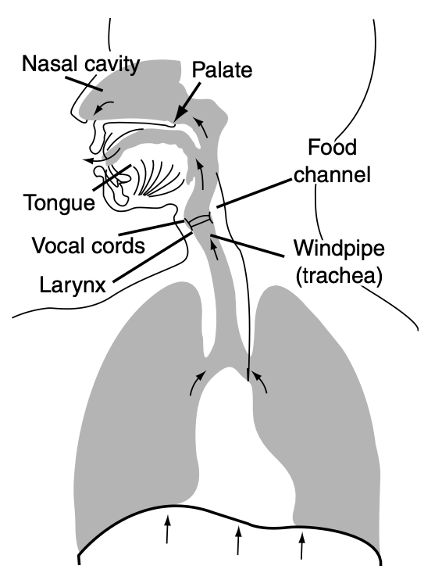
The speech mechanism
Articulatory organs
Oral/nasal cavity
Alveolar ridge
Tongue
Lips
Jaw
Phonatory organs
Vocal folds
Respiratory organs
Ingressive/eggressive airflow

Slide 9
What else could there be said about the sounds of speech?
When we turn from analyzing the physical aspects of speech sounds to studying their cognitive organization, we move from phonetics to phonology

Slide 10

phoneme
allophone
syllable nucleous
coda
syllable onset
stress
minimal pair
complementary distrubution
rhythm
connected speech forms
How do languages organize sounds to distinguish different words?
How do languages restict, or constrain, sequences of sounds?
How are sounds organized into larger constituents (syllables, words, phrases)?

Slide 11
Phonemes and allophones
When two sounds in a language form minimal pairs (that is, if their distribution is unpredictable and contrastive), those two sounds represent different phonemes.
When two sounds in a language are in complementary distribution (that is, their distribution is predictable and noncontrastive), the two sounds are allophones of the same phoneme.

Slide 12

Thank you

