Slide 1
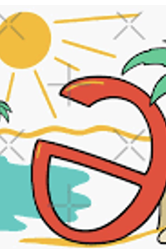
Summer Course
Phonetics & English Phonology 1
Encounter 2
Notes:
<number>

Slide 2

Stressed syllables (or rather the vowels of stressed syllables) are longer, louder, and higher in pitch, but in any given stressed syllable this entire combination of features may not be present.
The combination of unstressed, lightly stressed, and strongly stressed elements in multisyllabic words also characterises English utterances.
Notes:
<number>

Slide 3
Lexical stress
It is a fixed property of each word in the speaker’s mental lexicon. It is the stress pattern that the word has when spoken in isolation (as it appears in dictionary transcriptions)
In words of more than one syllable (polysyllabic /ˌpɒliːsɪˈlæbɪk/ words), it’s noticeable that one syllable stands out from the rest because it’s stressed, i.e. pronounced with more force than the surrounding unstressed syllables. For example, the first syllable is stressed in RIVer and the second syllable is stressed in forGET, proFESSor while the remaining syllables are unstressed.
Most short words have only one stress, called the primary stress, while many longer words have one or sometimes more additional stresses known as secondary stress.

Slide 4
The ‘Teutonic Rule’ /tjuˈtɒnɪk/
The English tendency is to alternate between stressed and unstressed syllables, so when the primary stress is on the third syllable, the secondary stress is usually on the first syllable (e.g. disappear /ˌdɪsəˈpɪə/).
This is known as the ”Teutonic Rule” : the first two syllables of a word cannot both be lexically unstressed.

Slide 5
Utterance stress
We use the term utterance stress to refer to the various stressed elements of each sentence/utterance.
Content words (i.e., a noun, verb, adverb, or adjective) carry a great deal of information, and are therefore more likely to be emphasised in a message.
Structure words (i.e., pronouns, prepositions, articles, “to be” verbs, conjunctions, auxiliary verbs) are usually not highlighted in a message. In fact, these less information-heavy words are usually de-emphasized. English speakers usually reduce (or weaken) them and as a result they are hard to hear.

Slide 6
Compare the stress pattern of some example words with utterances containing equal number of syllables and similar stress patterns.
Multisyllabic word
1. abandon
|əˈbændən |
2. guarantee
|ˌɡærənˈtiː |
3. communication
| kəˌmjuːnɪˈkeɪʃən |
4. identification
| aɪˌdentɪfɪˈkeɪʃən |
Utterance
1. I saw you.
| aɪ ˈsɔ: ju |
2. Can’t you see?
| ˌkɑːnt ju ˈsiː |
3. I think he’s got it
| aɪ ˌθɪŋk hɪz ˈɡɒt ɪt |
4. We went to the station.
| wi ˌwent tə ðə ˈsteɪʃən |

Slide 7
The unaccented weak forms of these words show reductions in the length of the sounds, obscuration of vowels towards /ə, i, ɪ, u, ʊ/, and the elision of vowels and consonants. (Cruttenden, p. 273)
How are they pronounced?
phonetic realization: Weak vowel system & elision of consonants and vowels
What is the effect in conversation?
understanding and conveying the right intended meaning
Impact in the rhythm of the language
function of weak and strong forms in conversation

Slide 8
the use of WF, SF and CF
Remember that WFs and CFs are far more frequent than SFs
/ʃi dræŋk frəm ə ˈbɒtl kɔːld drɪŋk mi /
WFs are used only if the function word is unstressed. Otherwise SFs must be used
huː kən kɪk ə ˈfʊtbɔːl frəm hɪər aʊt tu æfˈgænɪˌstæn? aɪ kæn !
SFs of the prepositions are used at the end of the intonation group, even if the word is unstressed.
| wen ælɪs dræŋk frəm ðə bɒtl kɔːld drɪŋk mi | wɒt wəz ʃi ˈθɪŋkɪŋ ɒv |
Pronouns form an exception in this respect, retaining the WF even in final position.
ʃi dræŋk frəm ə ˈbɒtl kɔːld drɪŋk mi

Slide 9
Remember that demonstrative “that” invariably has SF.
| ðæt pəʊɪm ɪz kɔːld ælɪs ən wəz rɪtən baɪ ən ɒstreɪliən raɪtə |
Relative pronoun “that” and conjunction “that” always have WFs
səʊ aɪm ɔːl əv ðə lʌv ðət kəd meɪk ɪt təˈdeɪ
WFs ending in /ə/, e.g. to, for /tə fə/, take on different forms before vowels
lɪzi ˈaʊər əʊ hæd səm ˈhəʊmˌwɜːk tə duː
tu ʌpləʊd

Slide 10
In WFs of words spelt with initial “h”, i.e. verb forms have, has, had, pronouns he, his, him, her, pronouncing /h/ is variable. The /h/ forms occur without exception at the beginning of an utterance but in other contexts both /h/ and /h/-less forms can be heard.
hiːz həʊm wɪð ðə fluː
rɪki wəz ɛl bət hiːz həʊm wɪð ðə fluː
rɪki wəz ɛl bət iːz həʊm wɪð ðə fluː
Have/has when used as a main verb implying possession usually retains SF. Do/does behaves in a similar manner. When used as a main verb, the SF is used.
lɪzi ˈaʊər əʊ hæd səm ˈhəʊmˌwɜːk tə duː
Notice that a few common function words have no regular WF. These include: if, in, on, one, then, up, when, what, with

Slide 11
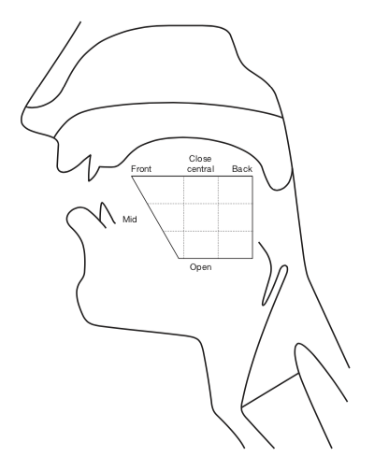
Producing vowel sounds
Open approximation
Considerable space between articulators
Air flow unobstructed
No friction
Voiced
Continuants
Classified in terms of
Quality
Quantity

Slide 12
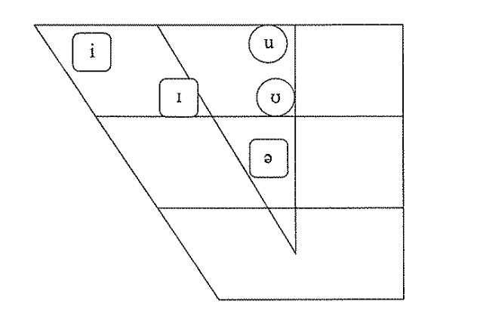
The weak vowel system

Slide 13
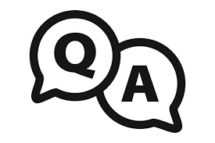
Thank you

