Slide 1

Summer Course
Phonetics & English Phonology 1
Encounter 3

Slide 2

The description and classification of speech sounds
Provide a phonological and a phonetic definition
of VOWELS and CONSONANTS
To what extent these definitions relate to CONTOIDS and VOCOIDS?

Slide 3
(l) Is the airstream set in motion by the lungs or by some other means? (pulmonic or non-pulmonic)
(2) Is the airstream forced outwards or sucked inwards? (egressive or ingressive)
(3) Do the vocal cords vibrate or not? (voiced or voiceless)
(4) Is the soft palate raised, directing the airstream wholly through the mouth, or lowered, allowing the passage of air through the nose? (oral, or nasal or nasalised)
(5) At what point or points and between what organs does closure or narrowing take place? (place of articulation)
(6) What is the type o f closure or narrowing at the point o f articulation? (manner of articulation)
Notes:
Phonological or phonetic description

Slide 4
Consontants
What to take into account to classify them?
To what extent do these concept relate to consonats?
Obstruents & sonorants
Fortis & lenis
Constriction
Voiced
+/- voice
Breath and muscular effort

Slide 5
(1) The position of the soft palate-raised for oral vowels, lowered for nasalised vowels.
(2) The kind of aperture formed by the lips-neutral, spread, close-rounded, or open-rounded.
(3) The part of tongue which is raised and the degree of raising.
Notes:
Phonological or phonetic description

Slide 6
Vowels
What to take into account to classify them?
To what extent do these concept relate to consonats?
Front – Central - Back
Close – Mid-close – Mid-open – Open
Quantity
Quality

Slide 7
Vowels: definition and description
Open approximation
Considerable space between articulators
Air flow unobstructed
No friction
Voiced
Continuants
Classified in terms of
Quality
Quantity

Slide 8
How are vowels described?

Slide 9
How are diphthongs classified?
Complete the criteria for classification.
Which diphthong falls into each category?
A) _____________ - the distance the tongue travels
Narrow
Wide
B) _____________ - the movement the tongue makes
Closing
Centring
Opening
C) _____________ - of the elements
Falling
Rising
Finch & Ortiz Lira (1982:32)
Notes:
Complete the classification
Which diphthong fall into that category
So, what to take into account to classify diphthongs
Diphthongs can be classified articulatorily and auditorily
According to the distance the tongue travels, they can be arculatory classified into “wide” - when the glide is long - and narrow - when the glide is short
Depending on the direction of the movement of the tongue makes in producing diphthongs, the English set can be articulatory calssified into “closing” and “centring” and the Spanish sit into “closiing and opening” Closing diphthongs involve a glide towards a closer tongue position; centring dish a glide towards a central position and opening a glide towards a more open postion.
According to prominence of the elements, diphthongs can be auditory classified into “falling” (when the first element is more prominent than the second) and “rising” (when the second element is more prominent than the first)
In Eng all diph are generally falling; in Spanish, all falling dish are closing and most rising ones are opening.

Slide 10
A) Distance - the distance the tongue travels
Narrow
FACE /eɪ/, GOAT /əʊ/, NEAR /ɪə/ and CURE /ʊə/
Wide
PRICE /aɪ/, MOUTH /aʊ/ and CHOICE /ɔɪ/
B) Direction - the movement the tongue makes
Closing
FACE /eɪ/, PRICE /aɪ/ and CHOICE /ɔɪ/
MOUTH /aʊ/ and GOAT /əʊ/
Centring
NEAR /ɪə/ and CURE /ʊə/
Opening
C) Prominence - of the elements
Falling
NEAR /ɪə/ and CURE /ʊə/
FACE /eɪ/, PRICE /aɪ/ and CHOICE /ɔɪ/
MOUTH /aʊ/ and GOAT /əʊ/
Rising
Notes:
Diphthongs can be classified articulatorily and auditorily
According to the distance the tongue travels, they can be articulatory classified into “wide” - when the glide is long - and narrow - when the glide is short
Depending on the direction of the movement of the tongue makes in producing diphthongs, the English set can be articulatory classified into “closing” and “centring” and the Spanish set into “closing and opening”
Closing diphthongs involve a glide towards a closer tongue position;
centring diph a glide towards a central position, and
opening ones a glide towards a more open position.
According to prominence of the elements, diphthongs can be auditory classified into “falling” (when the first element is more prominent than the second) and “rising” (when the second element is more prominent than the first)
In Eng all diph are generally falling;
in Spanish, all falling dish are closing and most rising ones are opening

Slide 11
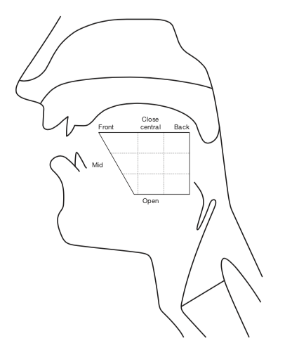

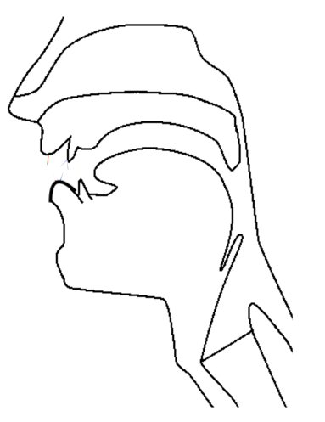
What kind of information does the head diagram provide? And the vowel chart?

Slide 12
Sample test
VIDEO 1
VIDEO 2
VIDEO 3
VIDEO 4

Slide 13

Thank you

