Slide 1

Summer Course
Phonetics & English Phonology 1
Encounter 4

Slide 2

Video Tasks
Watch the extracts from the film The English Teacher.
Analyse connected speech processes with quotes from the video.
What differences do you find between the characters in the production of the connected speech processes?

Slide 3

Video Tasks

Slide 4
Video Tasks
1. This is Robert, your English Teacher.
2. Why don’t you tell me a little about yourself?
3. Why you want to learn English?
4. I speak basic English.
5. Yes, of course, I’ll teach you.
6. My name Jin.
7. My name is Jin.
8. What is your name?
9. Sorry, I’m late.
10. P P P Pardon.

Slide 5
Video Tasks
11. Mr. Robert I ask question.
12. What did you want to ask me?
13. Are you happy?
14. Why did you transfer me £700?
15. I am your teacher, you are my student.
16. I can’t accept that money.
17. I will not let you down.

Slide 6
Words in connected speech
Differences often exist between the pronunciation of words in their cited, isolate forms and their pronunciation in connected speech, when they are subject to influences from other, surrounding sounds and from larger accentual and rhythmic patterns.
The differences may concern:
word as a whole
accentual pattern
word boundaries
This variation between isolate forms and context-influenced forms often depends on the style of speech.
Notes:
tendency in English to avoid adjacent accented syllables.

Slide 7
Differences in pronunciation
| kɑːnt ju siː |
| wi went tə ðə steɪʃən |
Words in connected speech
Word as a whole
Accentual Pattern
Word Boundaries
Weak forms
thir'teen
'thirteen 'pounds
after'noon
'afternoon 'tea
Linking
Elision
| ði əʊld mæn ən ðə siː |
| ˈmɪʃən ɪmpɒsɪbl |
| lʌndən taɪm |
| ə ˌpʌblɪk ˈlaɪbrəri |
| kʌvər ʌp |
| viːzər æplɪkeɪʃn |
| ðə bju:ti ʲ ən ðə biːst ǀ
ǀnaʊ ʷənd ðenǀ
| stri:t ͡ ɑːt |
Assimilation
Notes:
tendency in English to avoid adjacent accented syllables.

Slide 8

Features of connected speech
In rapid native-speaker speech, the reduction of full vowels to schwa is often accompanied by elision, assimilation, or coalescence.
Where do you want to go?
| weə dʒə wɒnə ɡəʊ |
These changes seldom cause problems for native speaker listeners, or for bilingual listeners. The same is not true, however, for many ELF interlocutors.

Slide 9

Reflexion from an ELF speaker
What native speakers do in order to facilitate things for themselves is not automatically relevant to what users of ELF need to do in order to be intelligible to each other. In other words, even if students of ELF were to be successful in their attempts to use schwa, assimilation, or coalescence, they would not be helping their non-native listeners.
Robin Walker (2010:42)

Slide 10
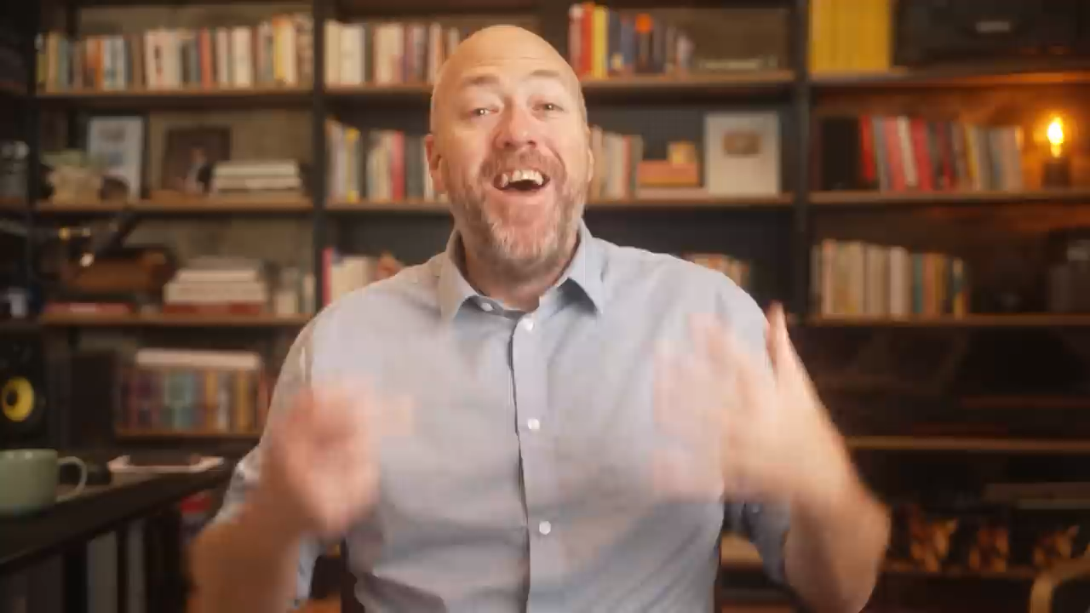
5 Tips for PERFECT English Pronunciation

Slide 11

Thank you

