Slide 1

Peer correction

Slide 2
Class work - Peer correction
Choose one of the following topics from the bibliography you have read and develop a 1 minute oral presentation
Schema
Genre
Is it well organised? (DEREEX – IBC)
Does it contain signposting devices? (Discourse markers)
What academic vocabulary does it contain? (AV)

Slide 3
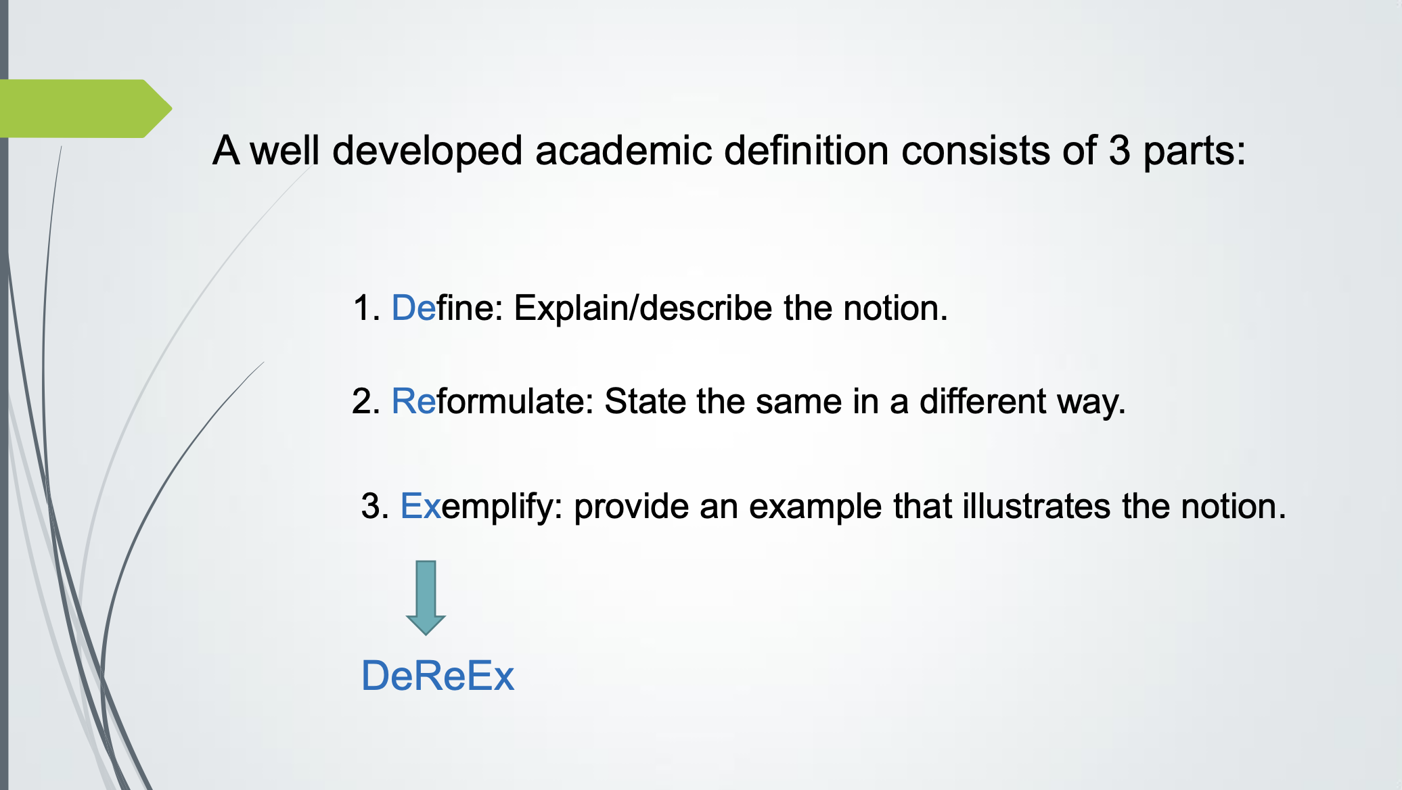

Slide 4
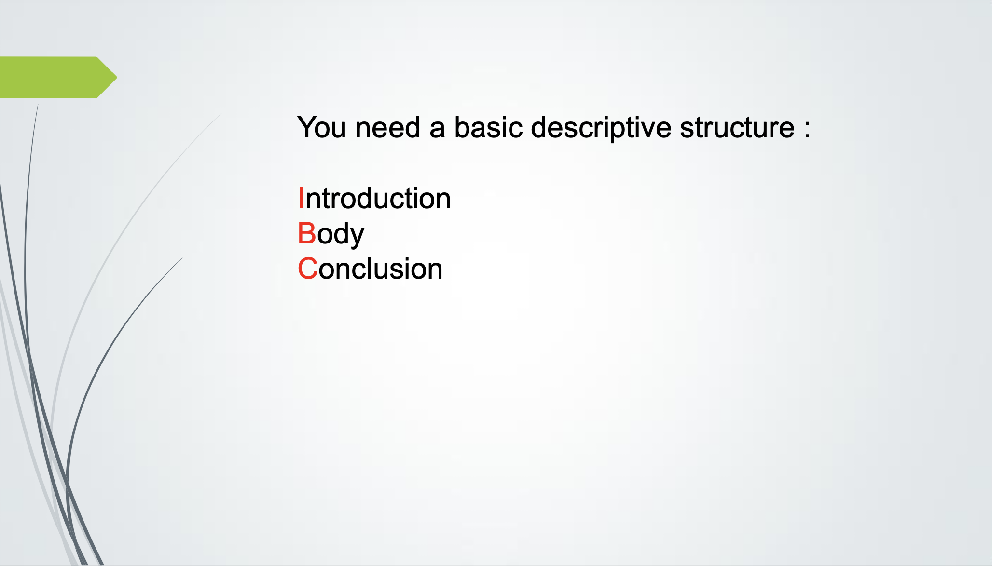

Slide 5
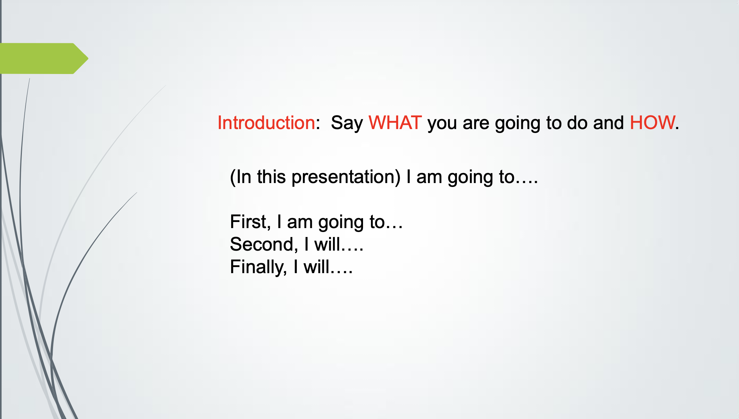

Slide 6
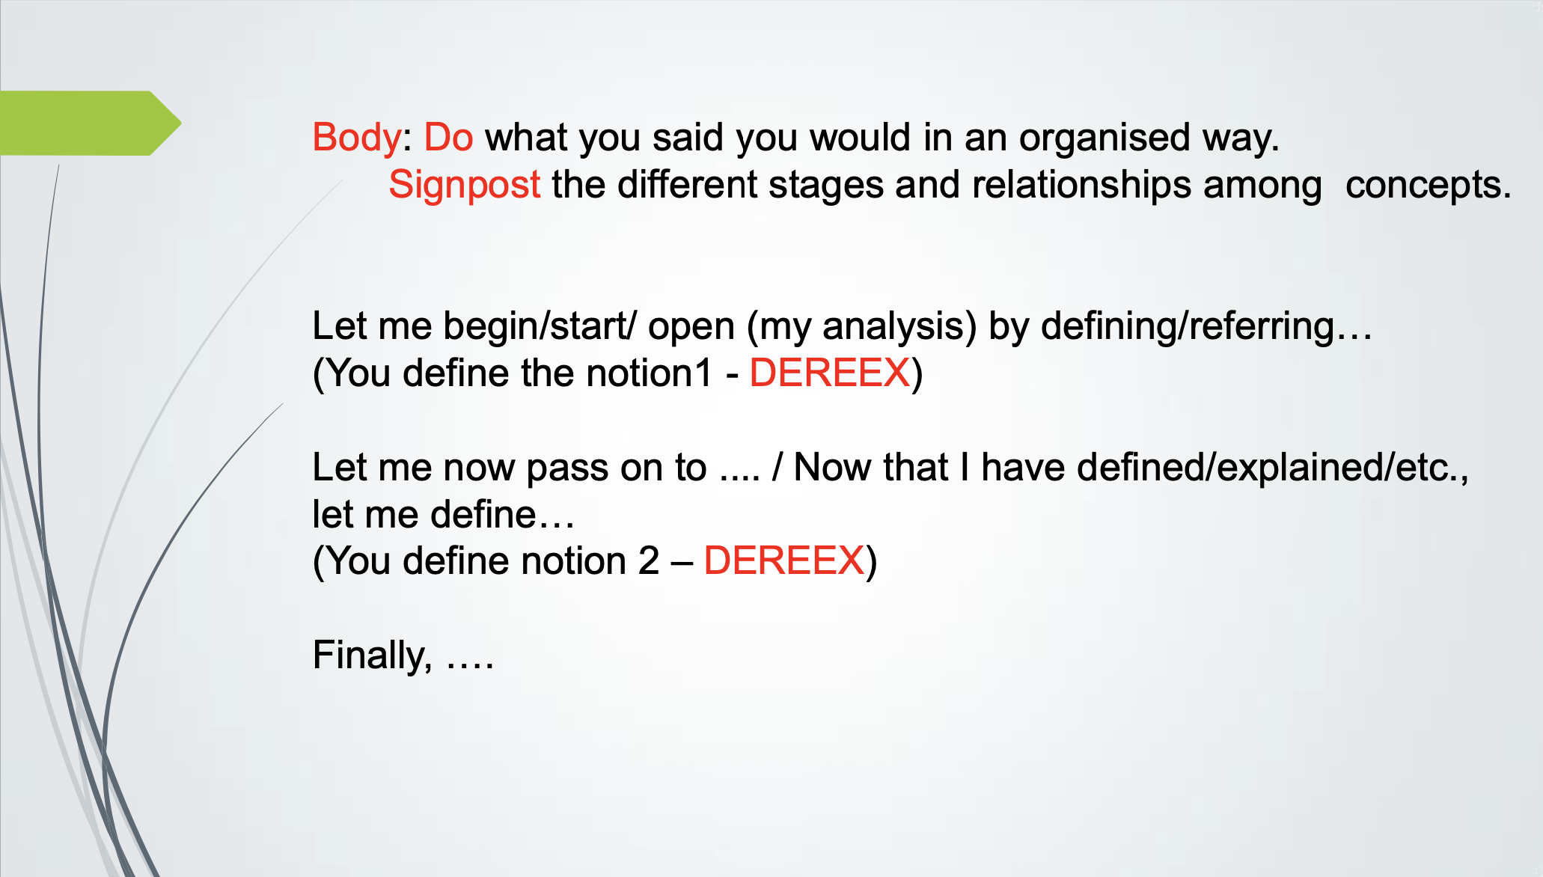

Slide 7
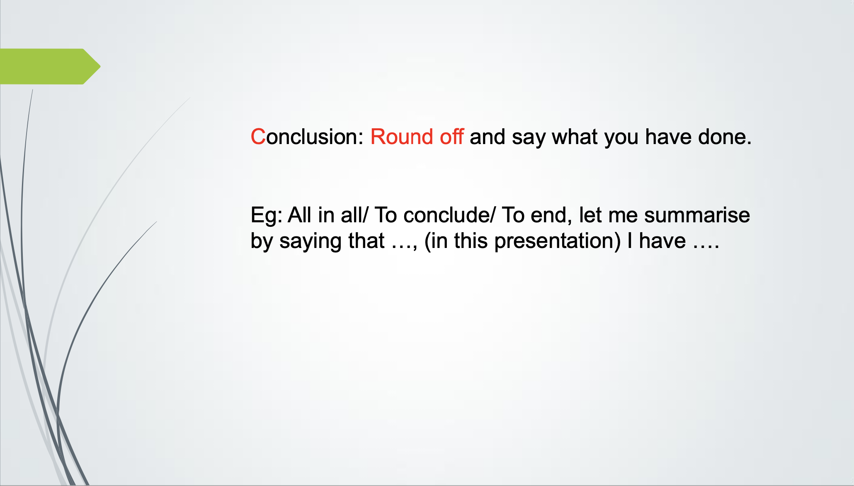

Slide 8
Feedback on 1-minute recording Pass/Pass + It follows the overall structure of a definition. Appropriate use of tone and prominence. Choices of grammar and lexis are genre appropriate. Barely satisfactory It barely follows the overall structure of a definition. Part of the definition is missing. Revise (reformulation, examples). There is/are no (examples or round off). Below standard The definition does not follow the theory analysed in class. Please revisit the material.

