Slide 1

Class work – peer correction
RevIsion & integration

Slide 2
Class work – peer correction
1-minute oral presentation
Choose one of the following topics from the bibliography you have read and develop a 1 minute oral presentation:
Schema
Genre
Record your presentation several times, choose the best performance and uploaded.

Slide 3
Defining & presenting Theoretical concepts
Remember to use all the knowledge on how to define and present theoretical concepts that we have learned in class so far.
Before sending your presentation, assess it upon this checklist:
Is it well organised? (DEREEX – IBC)
Does it contain signposting devices? (Discourse markers)
What academic vocabulary does it contain? (AV)

Slide 4
Assessment criteria
Feedback on 1-minute recording
Other comments
Pass/Pass +
It follows the overall structure of a definition.
Appropriate use of tone and prominence.
Choices of grammar and lexis are genre appropriate.
Appropriate use of use of discourse markers.
Barely satisfactory
It barely follows the overall structure of a definition.
Part of the definition is missing. Revise (reformulation, examples). /There is/are no (examples or round off).
Below standard
The definition does not follow the theory analysed in class. Please revisit the material.
Generally appropriate use of tone/ prominence/ tone unit boundaries.
Check word stress and the pronunciation of key words in your presentation. (eg. “schema” "interprete" are mispronounced)
Language is not always under control.
Revise lexical choices when defining (ex. “topic” for concept)
The definition lacks signposting devices.

Slide 5

Sample 1
Sample 2
Pass + It follows the overall structure of a definition. Appropriate use of tone and prominence. Choices of grammar and lexis are genre appropriate. Well done!
Bare Pass. It follows the overall structure of a definition. Yet, the definition is not introduced within the macro structure of a presentation. Very interesting introduction. Abrupt ending and no round off. Revise some choices of tone and prominence. Choices of grammar and lexis are genre appropriate but language in not always under control.

Slide 6

REVISION & INTEGRATION
Extract One
You hear a man talking about a harvest festival in China.
1 What is important to the man when eating a watermelon?
A its outward appearance
B its weight
C its flesh
2 What impressed the man most about the festival?
A the trade opportunities
B the educational dimension
C the cultural side

Slide 7
Extract Two
You hear part of an interview in which a journalist is talking about cookery books.
3 What is the journalist's main criticism of large cookbooks?
A The amount of information is slight.
B The recipes often prove to be unreliable.
C The quality of the photography is patchy.
4 What is unique about Wiliam Verrall's book, according to the journalist?
A the ingredients it uses
B its focus on the negative
C the strength of its humour

Slide 8
Extract Three
You hear a woman talking about her recent experience at a top-class restaurant.
5 What did she admire from its presentation?
A the spicy steak
B the barbecued fish
C the vegetarian option
6 What aspect of the restaurant was the woman somewhat disappointed with?
A the décor
B the furniture
C the atmosphere

Slide 9
You will hear part of a discussion programme in which a businessman called David and a linguist called Ivana ear speaking about the theme of symbols. For questions 1-5. choose the answer (A, B, C or D) which fits best according to what you hear.
1 The view is expressed that brands should
A symbolise something people enjoy.
B seek to utilise something visually unusual.
C learn to be more cooperative with each other.
D represent more than just a business proposition.
2 When talking about globalisation both speakers agree that
A the Internet has a huge influence.
B the positive symbols outweigh the negative ones.
C major sporting events are well-meaning but flawed.
D people are right to take a benevolent view.
3 What point does Ivana make about language?
A Some languages are particularly disposed towards symbols.
B Writers use symbols in the same way as everyone else.
C There is some debate as to what constitutes a symbol.
D Speakers of a language use symbols without realising it.
4 What does David say about the symbol ni shi hockey teams' name?
A It should really be changed.
B It's somewhat misleading.
C It was initially misinterpreted.
D It puts pressure on the team.
5 What do both speakers find absurd about colour symbolism and cars?
A the idea that a red car is any easier to see
B the notion of linking a driver's character with car colour
C the contradictory arguments used by one insurer
D the suggestion that insurers are influenced by cultural symbols

Slide 10
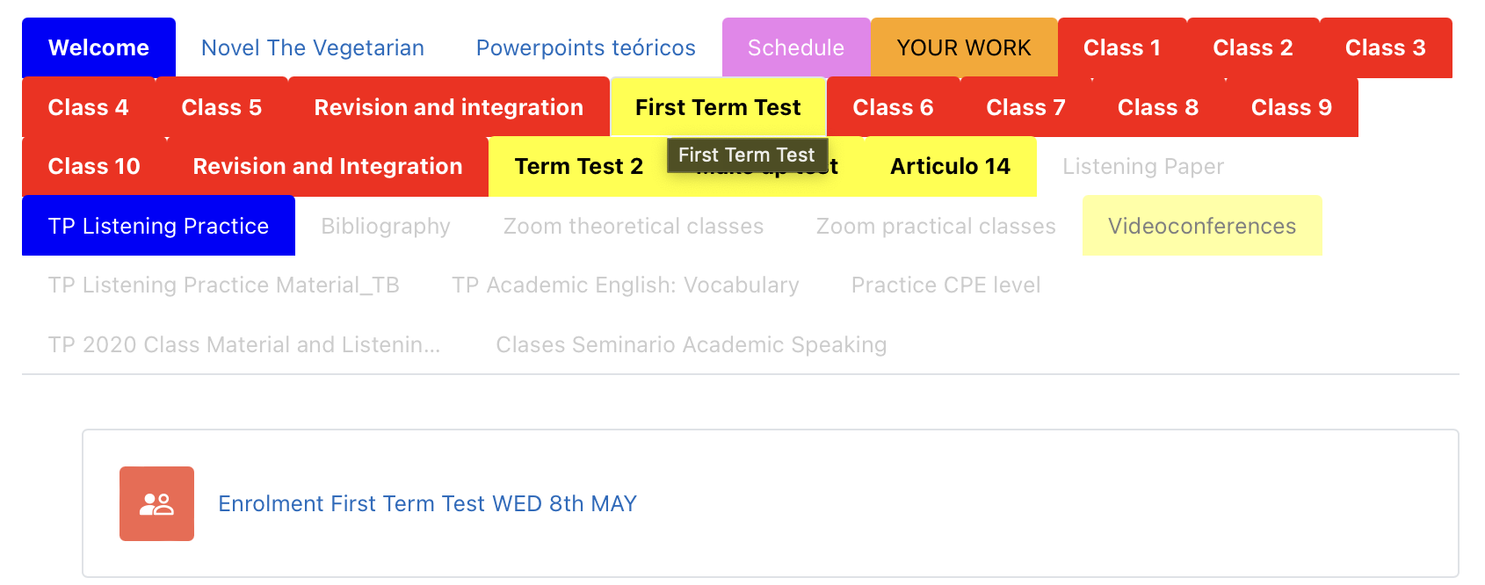
Enrolment First Term test

Slide 11
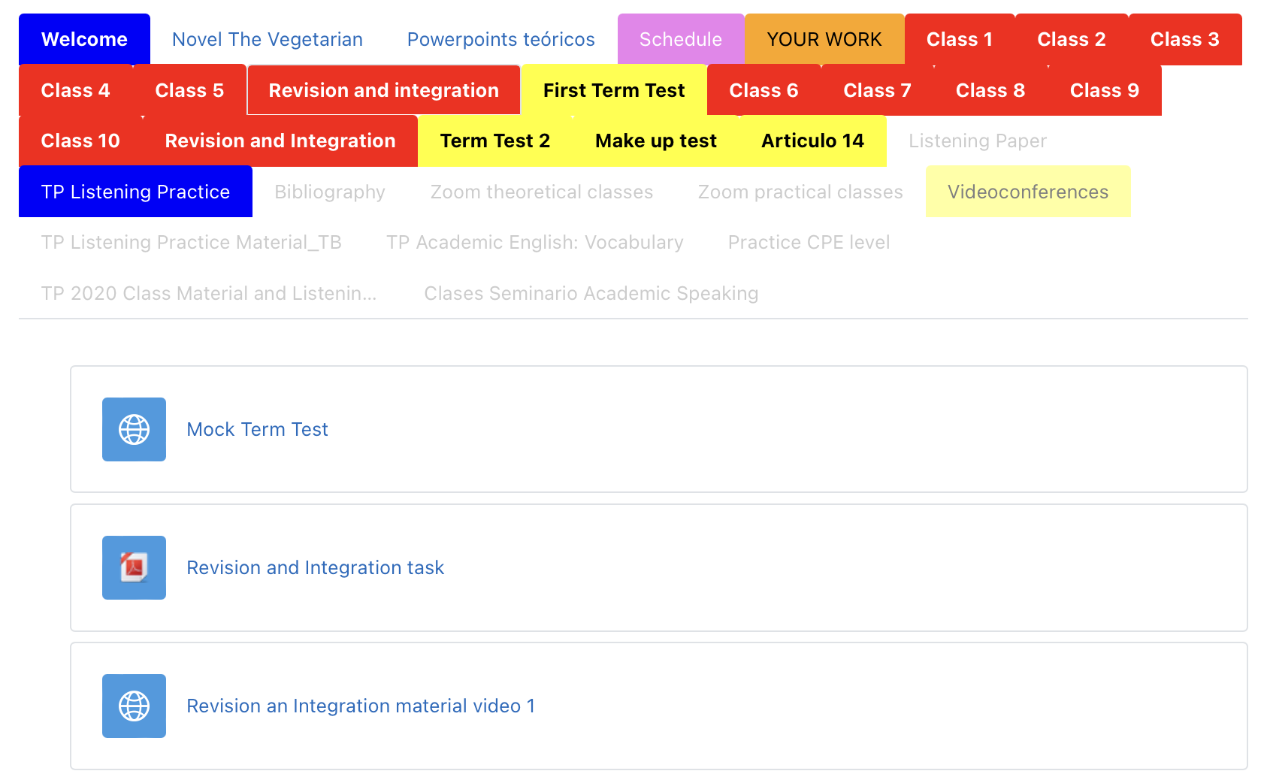
Mock test Revision & integration

