Slide 1

Dicción Inglesa 1 TP Class 1
Diagnostic test

Slide 2
House keeping TP classes
Mail - diccioninglesa1.fahce@gmail.com
Campus YOUR WORK
PM Booklet
TP Group
TP 1 Text & Discourse deadline Monday 31st March
Campus Novel The Vegetarian
Campus CLASS
In class listening practice
Extra listening practice

Slide 3
TRABAJOS PRACTICOS: CLASS 1 Listening Practice
Have a look at the test embedded in this document and check what the test consists of.
How many parts does the test include?
What are the tasks like?
Which tasks do you think will be more difficult to solve?
What are the differences between Part 1 and Part 3?

Slide 4
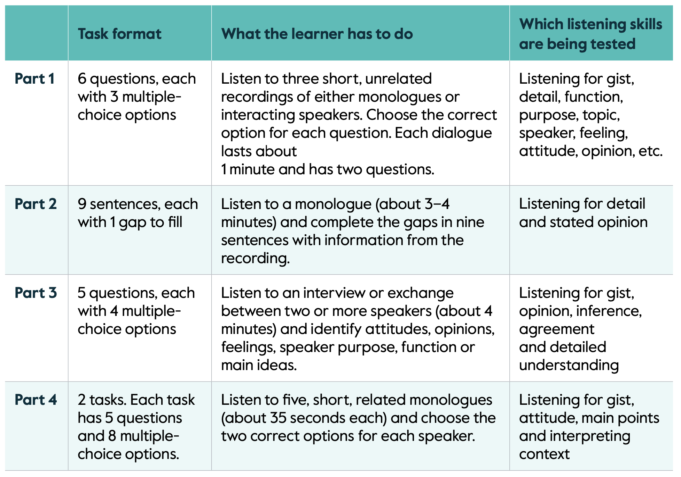

Slide 5
What is listening?
Developing listening skills
Processing spoken discourse
Strategies for listening comprehension

Slide 6
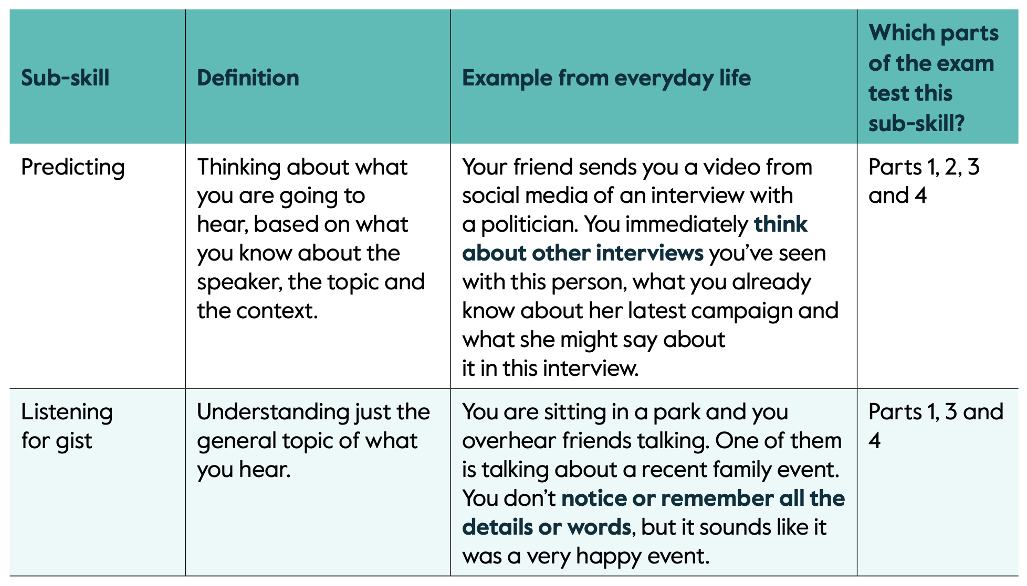

Slide 7
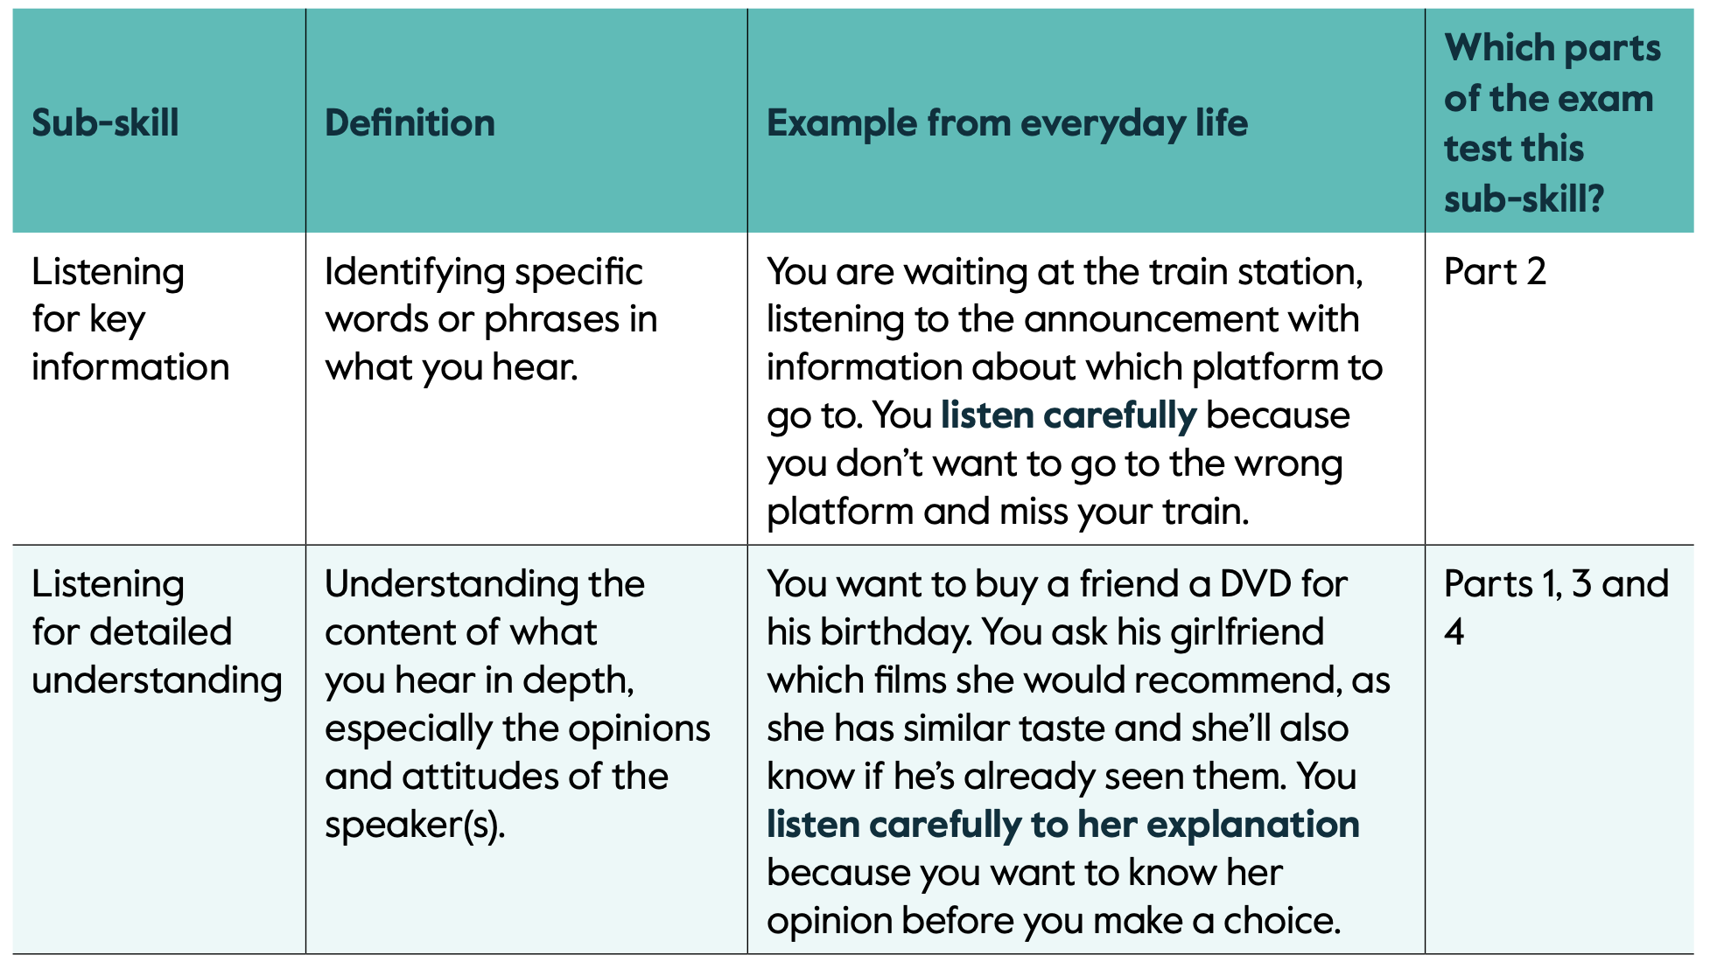

Slide 8
2. Reflection Task
After analysing the script and your answers, reflect on your performance:
Which parts of the test were the most difficult ones?
Think about the reasons which led you choose the wrong alternative/ word.
Where does the difficulty of each part lie on? For example, pace of delivery, unknown words/expressions, accent, characteristics of connected speech, others.

