Slide 1

The Vegetarian

Slide 2
Task 1: The Vegetarian
Pre-Task
General discussion
First impressions on the novel
Topics introduced
Intercultural issues
Q&A
Task
Character profile. You have to give a presentation to your classmates on the novel The Vegetarian:
a. describe physical appearance and personality traits
b. Introduce main characters
c. give your overall opinion of the novel

Slide 3
Links
Han Kang Interview: The Horror of Humanity
Point out the issues in the interview that
interest you the most.
Book Talk: The Vegetarian ! (aka
"That escalated kind of quickly")
https://www.youtube.com/watch?v=2Ql
xuwkoK8k
To what extent do you agree with the review?

Slide 4
“You’re insane! You’ve completely lost it.”
I crammed my feet into my recently purchased shoes, which were too narrow and pinched uncomfortably, threw open the front door and ran out. I checked whether the elevator was going to go all the way up to the top floor, and then dashed down three flights of stairs. Only after I’d managed to jump on the underground train as it was just about to leave did I have time to take in my appearance, reflected in the dark carriage window. I ran my fingers through my hair, did up my tie, and attempted to smooth out the creases in my shirt. My wife’s unnaturally serene face, her incongruously firm voice, surfaced in my mind.
I had a dream—she’d said that twice now. Beyond the window, in the dark tunnel, her face flitted by—her face, but unfamiliar, as though I were seeing it for the first time. However, as I had thirty minutes in which to concoct an excuse for my client that would justify my lateness, as well as putting together a draft proposal for today’s meeting, there was no time for mulling over the strange behavior of my even-stranger wife. Having said that, I told myself that somehow or other I had to leave the office early today (never mind that in the several months since I’d switched to my new position there hadn’t been a single day where I’d got off before midnight), and steeled myself for a confrontation.

Slide 5
Task 2: The Vegetarian
Pre-Task
Consider the features of conversation that might be present in the interaction between the husband and his boss when he is late for work.
Register
Language choice
Modes of discourse
Appraisal and involvement
Task
Work in groups:
Role play the conversation between the husband and his boss.
Take down notes of linguistic evidence of the features used.
How would the conversation have been different if he were describing the event to a friend?

Slide 6

The purpose of lectures
This class is based on the book Lectures: Learn Listening and Note-Taking Skills by Aish, F. and Tomlinson, J (2013) HarperCollins Publishers Ltd.
Chapter 1 The purpose of lectures

Slide 7
Discuss in groups
Define lectures and list their purposes.
Compare lectures with other spoken genres. Give examples.
What are lecturers and listener expected to do?
What can listeners do to overcome the difficulties to understand lectures?

Slide 8
Define lectures and list their purposes
A lecture is a talk given by a subject expert on a particular topic.
Lectures are talks which give students a general overview of a topic.
A lecture is meant to be an overview. It is up to you to research the topic in detail both before and after the lecture. The lecture is intended to give you a starting point for further study.
Current, general academic opinions on a topic.
Key definitions, names, dates, theories and facts.
Ideas for further research and reading.
A starting point for your own thoughts.

Slide 9
What are lecturers and listeners expected to do?
Do some preparatory reading. This will give you some background on the topic and make it easier to understand the lecture.
Find out what the lecture is about and look up some key words
Take notes while the lecturer is speaking.
Do not talk to other students. Try to concentrate during the lecture.
Do any follow up reading suggested by your lecturer.
Organize your notes and any handouts you are given. This will help with essay writing and revision in the future.

Slide 10
What can listeners do to overcome the difficulties to understand lectures?
Problems with subject specific vocabulary.
Problems with losing the path of the lecture.
Problems with general understanding.
Problems understanding sections of the lecture.

Slide 11
Compare lectures with other spoken genres. Give examples.
The lecturer has prepared what s/he is going to say in advance.
The lecturer speaks for a long time.
The students do not usually ask questions.

Slide 12
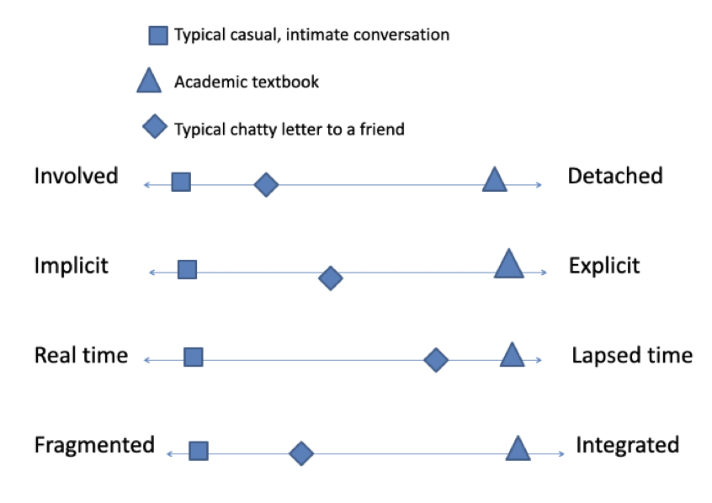

Slide 13
CLASS 6 PM_Lecture: Academic Study_John Slaght_University of Reading
What is the purpose of this lecture?
What are you expected to do?
Have you experienced any difficulty?
Lecture Academic Study
John Slaght
Part 1

