Slide 1
Dicción Inglesa 1
Clase Teórica
Prof. Barboni

Slide 2
Public talk is defined as the spoken interactions that take place in our everyday life with people we do not know well as we go to work, shop, visit the doctor, etc.
It is mainly transactional though there might be elements of interactional nature.
It takes place in worlds of education, business, media and other profesional contexts with a range of different audiences.
The spoken genres of public talk contain characteristic structural features that we recognise from previous experiences.
Public talk can be categorised as planned or unplanned.

Slide 3
Unplanned public talk genres:
Service encounters (business or profesional)
classroom interactions
court- room language
media talk ( including chat shows, radio phone-ins , sports commentaries)
public information language (eg air control)

Slide 4
Planned Public talk
Defined as that which is planned or scripted to accomplish accurate production devoid of the disfluency features of naturally occuring talk.
Genres:
Planned public speaking in legal and political contexts
Media genres (soap operas)
Game shows and stand up comedy
News broadcasting and documentary
The language of religion
The academic lecture

Slide 5
What do we refer to when we talk about Academic English?
For general purposes English For social purposes
for no particular objectives for varied communicative situations
(eg. At school) (eg. Shopping, chatting, etc.)
English for specific purposes
English for occupational/ professional purposes English for Academic purposes
(eg: doctors, hotel staff, airline pilots) in educational contexts and training
(eg: medicine, engineering, economics humanities)

Slide 6
Study skills:
The abilities, techniques and strategies used when using language for study purposes (reading, listening, speaking or writing)

Slide 7
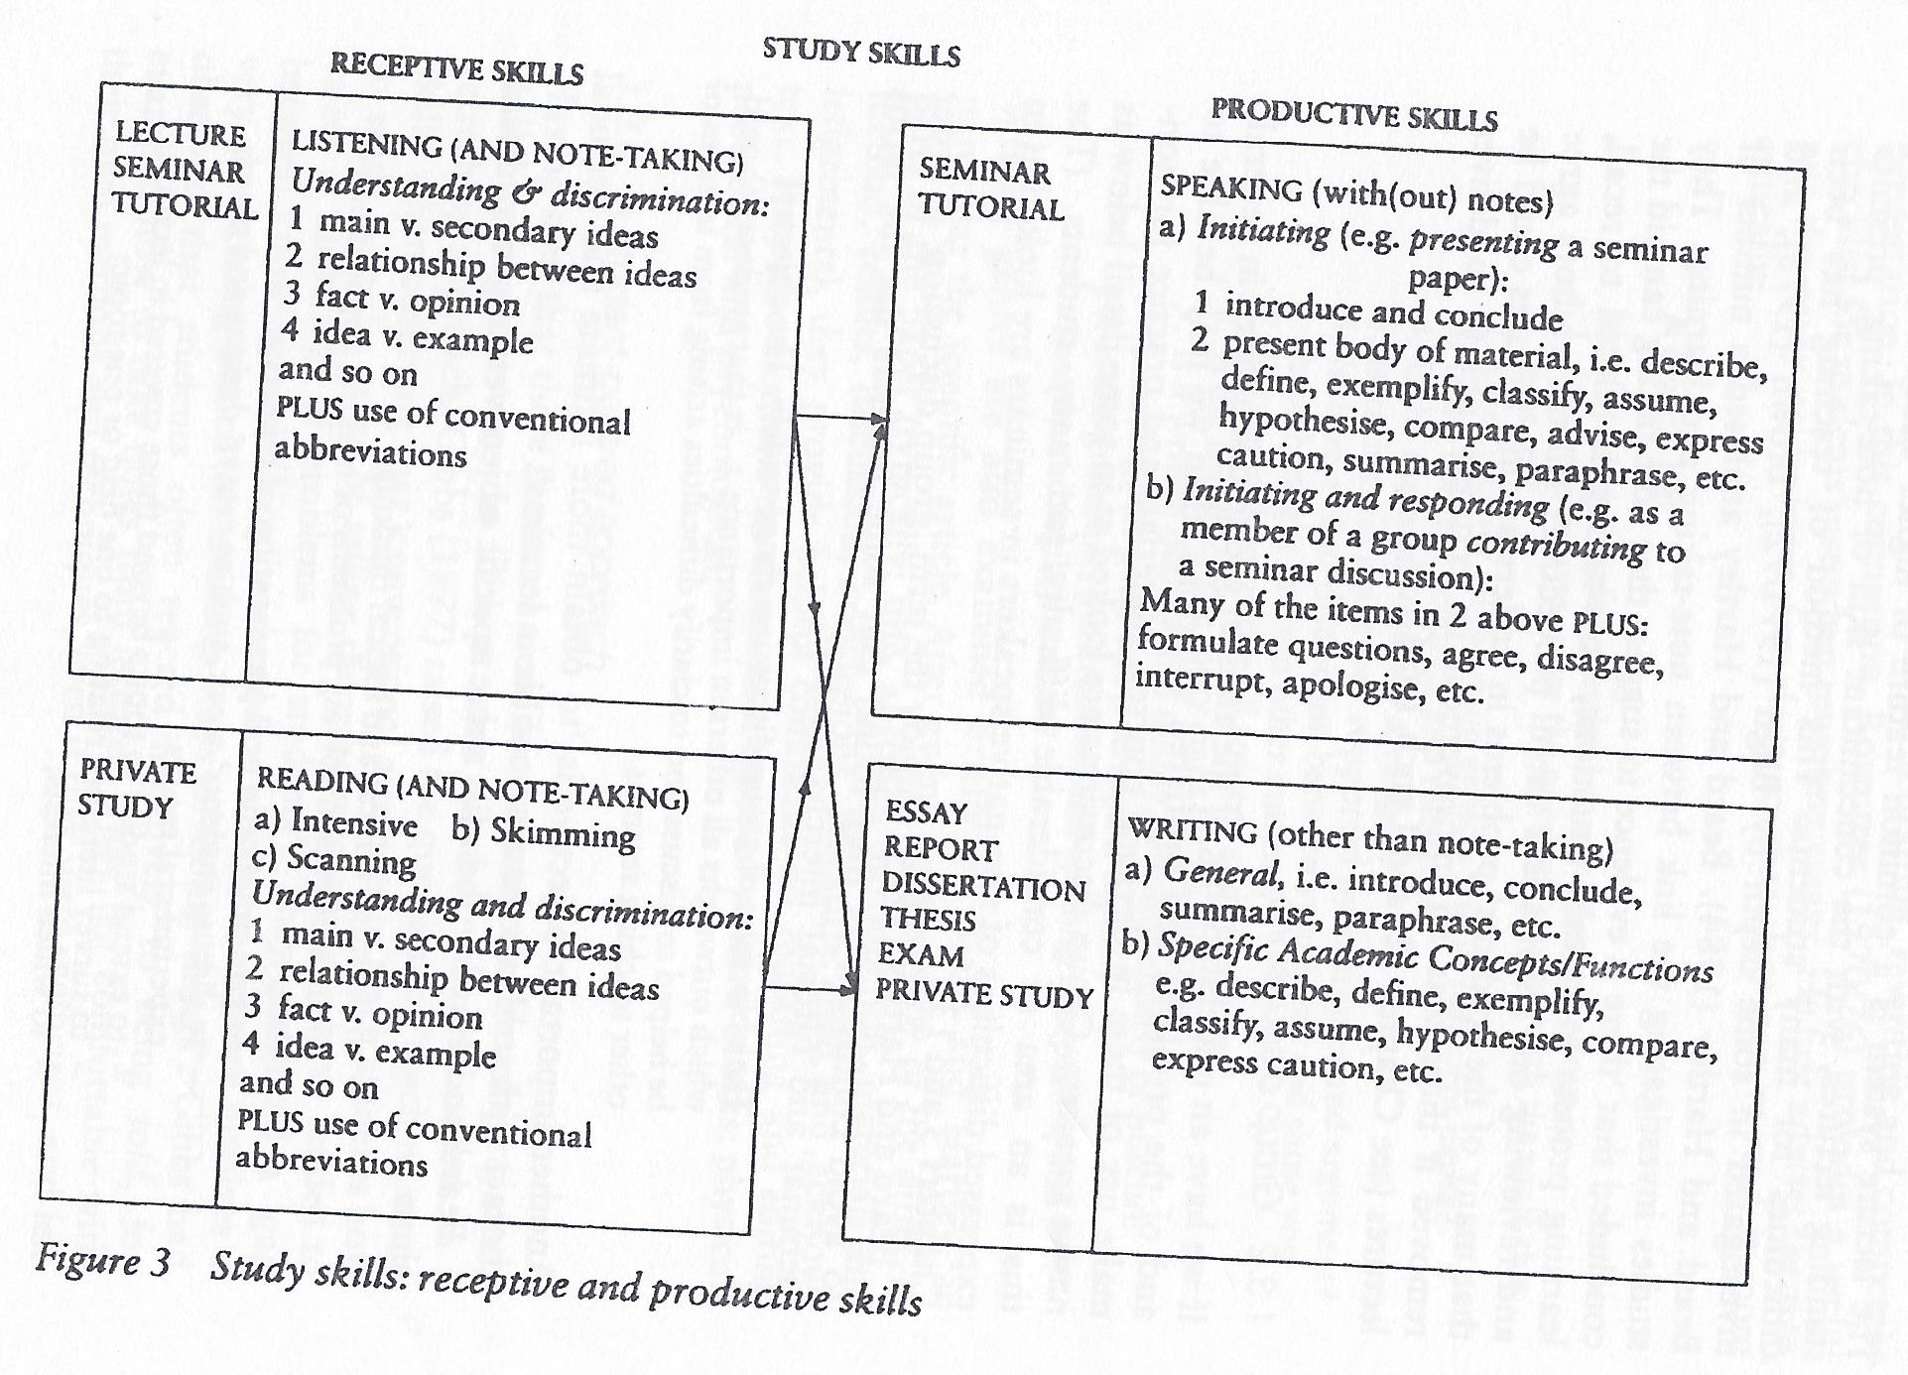

Slide 8
Problems students might find in lectures:
decoding what has been said (requires recognising pauses, boundaries, false starts, stress, intontation, etc considering the diverse lecturing styles)
comprehending (understanding key points and not key points – knowledge of specialist subject)
taking notes (a skill which involves several processes: distinguishing important information, deciding to record it, the ability to write it concisely and the ability to decipher one´s own notes)

Slide 9
Lecturing styles
Reading Style: the lecturer reads from notes (narrowness of intonational choices, falling tone predominates)
Conversational style: the lecturer speaks informally, with or without notes (longer tone groups and key sequences from high to low)
Rhetorical style: the lecturer is a performer (wide intonational range, with frequent asides and digressions)

Slide 10
The structure of lectures: Information vs Ideas
Identifiable patterns:
Descriptive
Argumentative
Historical
Case study
Problem – Solution
Process
Applying theory to practice
Cause –effect
Listening cues: lecturers normally use various devices to indicate the relative importance of the ideas and information contained in their lectures:
Prosodic features (stress, intonation, pauses)
subordinating syntactic structures (eg. Relative clauses)
Lexical discourse markers

Slide 11
Micro markers (lower order markers of segmentation and intersentential connections)
segmentation: well, OK, now, And, Right
Temporal: At that time, After this, Eventually
Causal: So, Then, Because
Contrast: But, Only, On the other hand,
Emphasis: Of course, Obviously, In fact, Naturally, etc.
Macro markers (higher order discourse markers signalling major transitions and emphasis in lectures)
What I´m going to talk about today is…
We´ll see that
Another interesting development was…
The problem here was…
Our story doesn´t finish here…
In this way…

Slide 12
De Carrico and Nattinger (1988) investigated lectures from different disciplines and found 8 main functional categories of macro- markers (chunks of language used to signal and indicate how information in a lecture is conveyed)
Topic markers
Topic shifters
Summarisers
Exemplifiers
Relators
Evaluators
Qualifiers
Aside markers

Slide 13
Note taking cues:
Introduction to an idea
Development of an idea
Contrast of several ideas
Results of ideas
Transition of ideas
Chronology of ideas
Emphasis of an idea
Summary of ideas

