Slide 1
Dicción Inglesa 1
Dr Silvana Barboni
Ciclo lectivo 2019
Clase 1

Slide 2
22/ 3 al 14/4
Unidad 1. La lengua oral.
Caracterización de la lengua oral. La noción de género y modo discursivo. Fundamentos de la lingüística de corpus en el análisis de la lengua oral.
Diferencias entre medio (medium) y modalidad (mode)
Los corpora y sus aplicaciones. Técnicas y usos.
Bax, S. (2011). Discourse and Genre: Analysing Language in Context. London: Palgrave. (Cap. 2, 3, 4).
Carter, R. & Mc Carthy. (2017). “Spoken Grammar: Where Are We and Where Are We Going?.” Applied Linguistics 2017: 38/1: 1–20.
Flowerdew, L. (2012). Corpora and Language Education. London: Palgrave. (Cap. 1 y 4).
Bakhtin, M.M. (2014). The Problem of Speech Genres. In Jaworski and Copland (Eds.) The Discourse Reader. London: Routledge. (pp. 73-82).

Slide 3
We are arguably living at a point of major historical disjuncture, with millions of refugees struggling to find alternative places to survive among increasingly reluctant and hostile hosts while walls and fences become the new response to mobile populations; with the rise of trenchant forms of xenophobic and isolationist populism in Europe, the USA and elsewhere driving deep divides between people of different backgrounds and faiths while new forms of religious fundamentalism draw deeper battle lines between people; with the redistribution of income away from labour and towards profit bringing greater inequality as capital is concentrated in the hands of the very rich while huge economic disparities are ideologically normalized; with a new emergent class of mobile, impoverished and insecure workers supporting growing extravagances by the wealthy while the very idea of welfare and the public good is increasingly on the retreat; with human rights abuses escalating in many parts of the world while the idea of universal justice struggles to make those abusers accountable
(Pennycook, 2018)

Slide 4
Posthumanism may refer to a range of concerns:
a questioning of the centrality and exceptionalism of humans as actors on this planet,
the relationship to other inhabitants of the earth,
a reevaluation of the role of objects and space in relation to human thought and action,
the extension of human thinking and capacity through various forms of human enhancement

Slide 5
“For millions of years, mankind lived just like the animals. Then something happened which unleashed the power of our imagination. We learned to talk and we learned to listen. Speech has allowed the communication of ideas, enabling human beings to work together to build the impossible. Mankind’s greatest achievements have come about by talking, and its greatest failures by not talking. It doesn’t have to be like this. Our greatest hopes could become reality in the future. With the technology at our disposal, the possibilities are unbounded. All we need to do is make sure we keep talking.” Stephen Hawking

Slide 6
According to Bakhtin:
Language enters into life through concrete utterances (which manifest language) and life enters language through concrete utterances as well.
To learn to speak means to learn to construct utterances (because we speak in utterances and not in individual sentences or words).
An utterance is defined as a unit of speech communication which boundaries are determined by a change of speaking subject. It is not a conversational unit but a real one.
Any utterance is a link in a very complexly organised chain of other utternaces.
All our utterances have definite and relatively stable typical forms of construction of the whole.

Slide 7
We speak in definite speech genres. We cast our speech in definite generic forms, sometimes rigid and trite ones, sometimes more flexible, plastic and creative ones.
Speech genres organise our speech in almost the same way as grammatical (syntactical) forms do.
A speech genre is not a form of language but a typical form of utterance.
Genres correspond to typical situations of speech communication, typical themes, and, consequently, also to particular contacts between the meanings of words and actual concrete reality under certain typical circumstances.

Slide 8
Traditionally descriptions of language focused exclusively on written language (written genres)
A description of both oral and written language is needed for:
Accurate descriptive work in applied linguisitcs (theory development and research)
Pedagogic purposes (teaching)

Slide 9
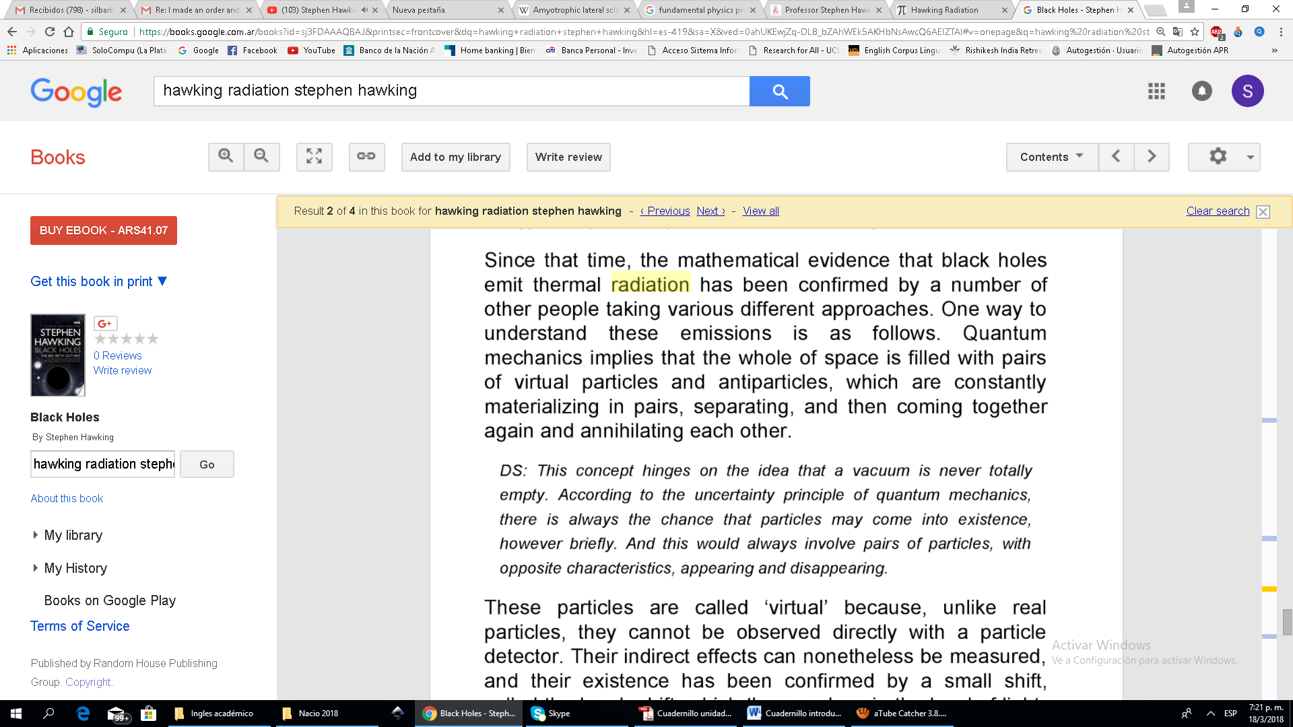
Let us consider some examples:
“Remember to look up at the stars and not down at your feet. Try to make sense of what you see and wonder about what makes the universe exist. Be curious. And however difficult life may seem, there is always something you can do and succeed at. It matters that you don’t just give up.”

Slide 10
Typical casual, intimate conversation
Academic textbook
Typical chatty letter to a friend
Involved Detached
Implicit Explicit
Real time Lapsed time
Fragmented Integrated

Slide 11
The intermingling of styles led Carter and McCarthy to distinguish:
MODES of communication (more or less speakerly or writerly)
from
MEDIUMS of communication (spoken or written)
Re positioning the usual dichotomy between written and spoken language.
Eg: emails - academic presentations

Slide 12
Text - Discourse
(text linguistics) (discourse analysis)
Often used interchangeably to refer to a stretch of language beyond the sentence.
Text is the product of language use.
Discourse is the process of meaning creation and interaction.

Slide 13
What is a text?
It is an actual instance of language both spoken or written.
It is the manifestation of language in the world drawing on our mental ideas of genre for particular functional and communicative purposes.
It has texture in that it functions as a unity with respect to its environment.

Slide 14
What does discourse analysis study?
Authentic texts produced in context.
A text of any size written or spoken.
Texts are studied in terms of the contexts in which they are found.
Texts are studied in terms of their intertextual relations with other texts.
Texts are analysed with reference to the ideologies and viewpoints which underpin them.
Texts are analysed with reference to their socio-political implications and consequences.

Slide 15
Mental representations in text comprehension:
Concept :
the most basic mental entity
Mental model:
A conceptual structure

