Slide 1
Dicción Inglesa 1
Dr Silvana Barboni
Ciclo lectivo 2019
Class 2

Slide 2
Schemas:
A set of interrelated features which we associate with an entity or a concept.
Clusters of mental concepts which we draw on to interpret the world around us and also to interpret language.
Well integrated chunks of knowledge about the world, events, people and actions.
Concepts or mental structures that we develop through experience, which allow us to interpret the world and also share interpretations with others.
Three types:
World knowledge (the content schema of a text)
Knowledge built from the text so far (meaning creation)
Previous experience with the type of text (text schema)

Slide 3
Frame: non sequential sets of concepts
Script: a conventional sequence of activities, a socioculturally defined protocol for negotiating or understanding a situation.
Genre schema: the ways in which we draw on and make use of the prior knowledge of all aspects of genres including their typical contexts, forms, functions, lexis and grammar which we bring to bear as we interpret written and spoken texts.

Slide 4
Genres
A genre is a kind of text. Academic lectures and casual conversation are examples of spoken genres. Newspaper reports and academic essays are examples of written genres. (Paltridge, 2006: 84)
Genre is a staged, goal oriented, purposeful activity in which speakers engage as members of our culture. Examples of genres are staged activities such as making a dental appointment, buying vegetables, telling a story, writing an essay, applying for a job… (Martin, 2011: 155)
Genres are diverse ways of acting, of producing social life, in the semiotic mode. (Fairclught, 2003: 206)
A genre comprises a class of communicative events, the members of which share some set of communicative purposes. These purposes are recognised by the expert members of the parent discoursecommunity and thereby constitute a rationale for the genre. This rationale shapes the schematic structure of the discourse and influences and constraints choice of content and style (Swales, 1990: 58)

Slide 5
Genres are guided by their purposes, in other words, by the functions which they are intended to fullfil. The purposes expressed in genres are defined by the community which uses them, not by the individuals; shared rules must be learned and used for genres to operate.
The key function of the genre governs the other features of the genre, its structure, content, lexis and grammar and so on.

Slide 6
Key defining features of genres:
They are akin to mental structures such as concepts and schemas
They are ideal whereas texts are real
They may include language or not
They are shared as mental constructs by members of a particular community
They have particular names though not always
They are characterised by their function(s)
Their function guides their features (structure, layout, style, lexis, grammar)
They have a structure
They are identified by social and contextual factors as well as formal criteria
They are flexible, change, evolve, bend and die out.

Slide 7
Discourse modes:
Modes of thought and discourse that represent clear ways of interpreting the world and «of drawing meaning from interactions with the world» (Grabe, 2002: 252)
They are abstract ways of expressing relationships about the world. They can enter in flexible ways into various genres making it possible for a genre to draw on one or more modes.
They are modes of operating with the language, a superordinate level above genres and texts. They are pre- genres.
They do not have a specific social function in themselves, insteade they are building blocks which we can draw on in many different genres and then use in actual texts in flexible ways for a range of purposes.

Slide 8
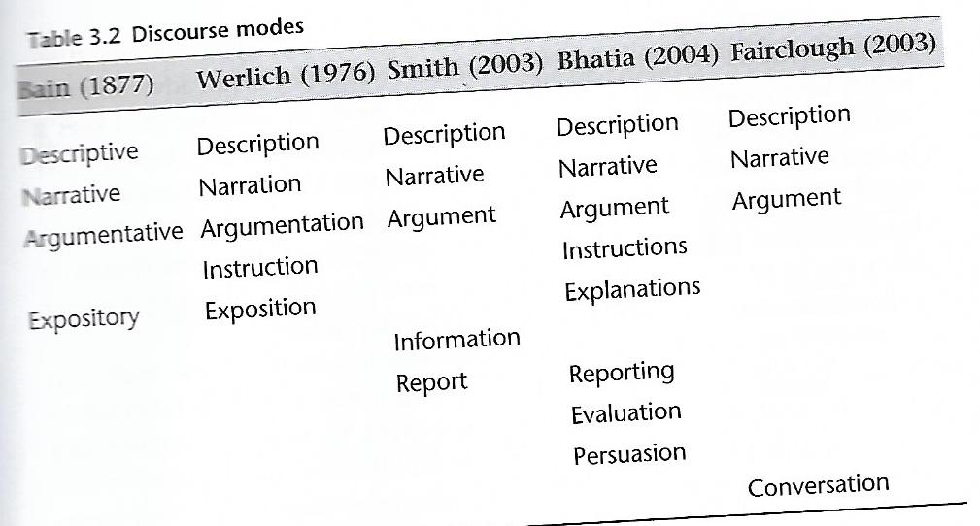

Slide 9
Narrating
Interacting
Describing
Reporting
Instructing

