Slide 1
Dicción Inglesa 1
Clase teórica
Dr Silvana Barboni

Slide 2
Discourse modes:
Modes of thought and discourse that represent clear ways of interpreting the world and «of drawing meaning from interactions with the world» (Grabe, 2002: 252)
They are abstract ways of expressing relationships about the world. They can enter in flexible ways into various genres making it possible for a genre to draw on one or more modes.
They are modes of operating with the language, a superordinate level above genres and texts. They are pre- genres.
They do not have a specific social function in themselves, instead they are building blocks which we can draw on in many different genres and then use in actual texts in flexible ways for a range of purposes.
They can be characterised and distinguished in terms of their relationship to the world and also by their internal linguistic features. They relate to time and place in different ways.

Slide 3
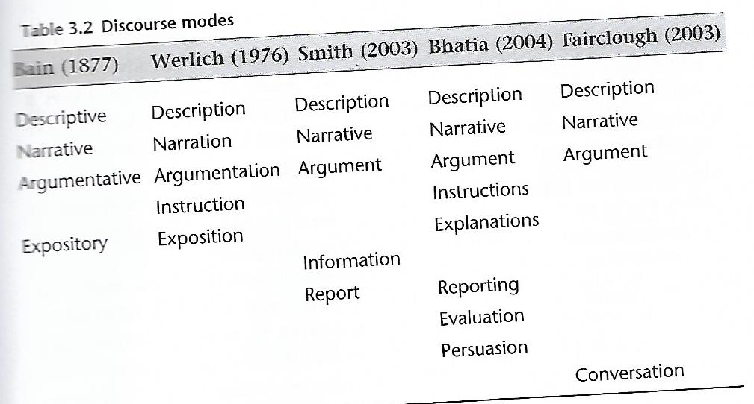

Slide 4
Narrating
Interacting
Describing
Reporting
Instructing

Slide 5
Narrating mode: TASK

Slide 6
CORPUS
A corpus consists of authentic, naturally occurring data;
A corpus is assembled according to explicit design criteria;
A corpus is representative of a particular language or genre;
A corpus is designed for a specific linguistic or socio- pragmatic purpose
A corpus is a collection of naturally occurring language text, chosen to characterize a state or variety of a language. In modern computational linguistics, a corpus typically contains many millions of words: this is because it is recognized that the creativity of natural language leads to such immense variety of expression that it is difficult to isolate the recurrent patterns that are the clues to the lexical structure of the language. (Sinclair 1991: 171)

Slide 7
Size: 100 million to 500 million words
A corpus should be large to give an adequate representation of the language and sufficiently multiple occurrences of the items under investigation. «A sizeable sample of real-life usage»
The lower the frequency of the feature, the larger the corpus.
Smaller corpora can be used for investigating the more common features of language.
A corpus is a «social artefact»: more qualitative data for examining very specific sub-purposes concerning socio-pragmatic behaviour, which could easily be overlooked in larger-scale quantitative analyses.

Slide 8
Sinclair’s ten key principles for developing linguistic corpora
1. The contents of a corpus should be selected without regard for the language they contain, but according to their communicative function in the community in which they arise.
2. Corpus builders should strive to make their corpus as representative as possible of the language from which it is chosen.
3. Only those components of corpora which have been designed to be independently contrastive should be contrasted.
4. Criteria for determining the structure of a corpus should be small in number, clearly separate from each other, and efficient as a group in delineating a corpus that is representative of the language or variety under examination.
5. Any information about a text other than the alphanumeric string of its words and punctuation should be stored separately from the plain text and merged when required in applications.

Slide 9
6. Samples of language for a corpus should wherever possible consist of entire documents or transcriptions of complete speech events, or should get as close to this target as possible. This means that samples will differ substantially in size.
7. The design and composition of a corpus should be documented fully with information about the contents and arguments in justification of the decisions taken.
8. The corpus builder should retain, as target notions, representativeness and balance. While these are not precisely definable and attainable goals, they must be used to guide the design of a corpus and the selection of its components.
9. Any control of subject matter in a corpus should be imposed by the use of external, and not internal, criteria.
10. A corpus should aim for homogeneity in its components while maintaining adequate coverage, and rogue texts should be avoided.
(Extracted from Sinclair 2005: 1–21)

Slide 10
A corpus is different from, and not to be confused with, a database, or text archive
A database, or text archive is a large repository of text which is unstructured and often compiled according to what is easily obtainable rather than based on systematic sampling techniques. There is also a difference in the ‘reading’ of a corpus vs a database: a corpus is read non- linearly whereas it is usually a whole text which is accessed in a database.

Slide 11
The World Wide Web is not a corpus, because its dimensions are unknown and constantly changing, and because it has not been designed from a linguistic perspective.
Investigations of corpora, in common with all linguistics, are concerned with the description and explanation of the structure and use of language. However, two key defining features of corpus- based linguistics are that the analyses are based on empirical data and tend to be associated with the phraseological approach to language

Slide 12
Stubbs (2001a: 59)
phraseology : ‘the pervasive occurrence of phrase- like units of idiomatic language use’.
phraseological units ‘… have typical components, but are highly variable, with probabilistic relations between the components; they are typically realised by a sequence of several word forms, but their boundaries do not correspond systematically to syntactic units’
While some linguists prefer the term phraseology (e.g. Cowie 1998), others opt for formulaic language or sequences (Wray 2002). The term ‘ multi- word unit’ is also commonly found as an alternative. See Wray (ibid.: 9) who lists over 50 different terms to describe this phenomenon.

Slide 13
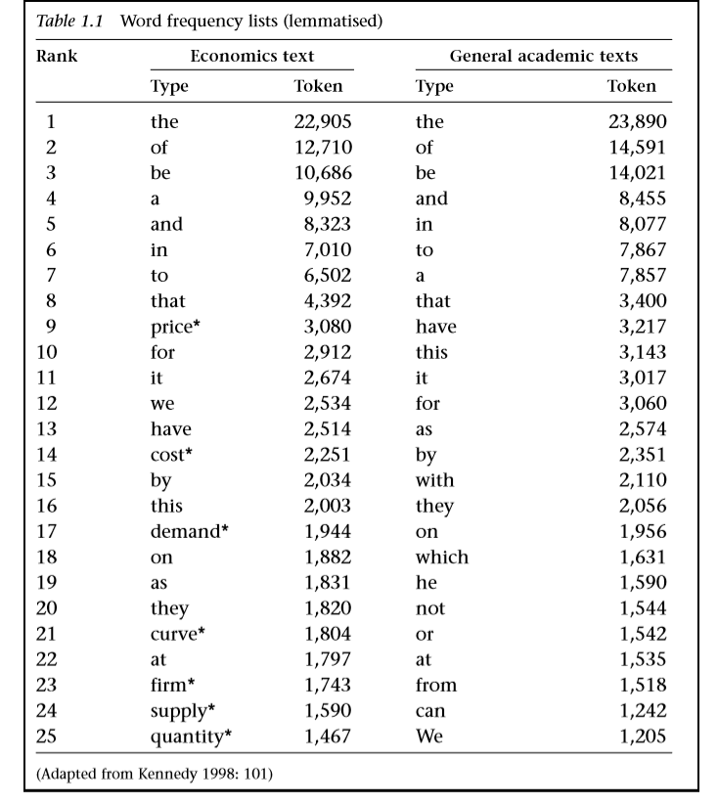
1. Frequency data
The starting point for analysis is usually with frequency counts of lexical items.
A frequency list for a corpus shows you the words that occur in it and the relative proportion that each contributes towards it. If your corpus is properly representative, this information can give you a reasonably accurate picture of the language as a whole.

Slide 14
2. Collocational data
A corpus is regarded as indispensable for observing collocational patterning, visible through the vertical display of the node word
Collocations are a familiar (institutionalized), stored (memorized) word- combination with limited and arbitrary variation.
A corpus is regarded as indispensable for observing collocational patterning, visible through the vertical display of the node word (i.e. the word form or lemma under investigation, commonly known as KWIK, keyword in context) and its collocate(s), i.e. word or words with which it co- occurs. It is generally agreed that collocational behaviour of a lexical nature can be manifested up to a span of four or five words to the left or right of the node word.

Slide 15
The semantic prosody of a lexical item is a consequence of the more general observation that meaning can be said to belong to whole phrases rather than to single words. Semantic prosody can be observed only by looking at a large number of instances of a word or phrase, because it relies on the typical use of a word or phrase. It accounts for ‘connotation’: the sense that a word carries a meaning in addition to its ‘real’ meaning. The connotation is usually one of evaluation, that is, the semantic prosody is usually negative or, less frequently, positive. It can be exploited, in that a speaker can use a word in an atypical way to convey an ironic or otherwise hidden meaning. The semantic prosody of a word is often not accessible from a speaker’s conscious knowledge. Few people, for example, would define SET in as meaning ‘something bad starts to happen’, but when the negative connotation is pointed out in many cases it accords with intuition (A spell of fine weather set in sounds very odd, for example).

Slide 16
3. Colligational data
colligation, a term first coined by Firth (1957: 13) to denote ‘the grammatical company a word keeps’ (cited in Hoey 1997: 8), and most commonly viewed as a type of relation bridging lexis and grammar. Like collocation, colligation is usually viewed as a probabilistic phenomenon rather than a term for describing rule- governed language, e.g. which verbs are followed by an infinitive or ‘that’ clause. Hoey’s definition of colligation given below and corpus findings will act as the pivot for the discussion in this section.
The basic idea of colligation is that just as a lexical item may be primed to co- occur with another item, so also it may be primed to occur in or with a particular grammatical function. Alternatively it may be primed to avoid appearance in or co- occurrence with a particular grammatical function….
colligation can be defined as:
the grammatical company a word or word sequence keeps (or avoids keeping) either within its own group or at a higher rank;
the grammatical functions preferred or avoided by the group in which the word or word sequence participates;
the place in a sequence that a word or word sequence prefers (or avoids).

Slide 17
4. Lexicogrammatical patterning
Stubbs’ (1996: 36) well- known phrase ‘There is no boundary between lexis and grammar: lexis and grammar are interdependent’ aptly conveys this convergence between the two.
In the lexico- grammatical approach meaning and usage, uncovered through recurring concordance examples, have primacy, i.e. language is viewed as a ‘grammaticalised lexis’ rather than a ‘lexicalised grammar’. It can also readily be seen that the starting point for linguistic analysis tends to be with the lexical item,
The groundbreaking research of corpus linguists such as Sinclair, Stubbs, Hoey and Hunston has set the road map for a more linear, syntagmatic approach to language analysis, where vocabulary and grammar are seen not as two polarities but brought together as a unified whole.

Slide 18
Corpus linguistic methodologies have indeed been invaluable in showing how inextricably bound together vocabulary and grammar are, but there is still a way to go in the working out of an all- encompassing theory to offset the main limitations outlined :
They are limited in size: they are not fully representative.
A corpus presents decontextualised language data divorced from its original context in large scale analysis.
Corpus analyses are limited by tools which take a ‘bottom up’, i.e. a micro- view of the text, rather than a ‘top down’ approach (Swales 2002, 2004), and that due to these technological restrictions, corpus investigations over- emphasise single word forms and collocations at the expense of more discourse- based features of language.
Difficulties with interpretation (possibility – acceptability; sociopragmatic decoding of a text).

Slide 19
What are the relationships between Corpus Linguistics and Discourse Analysis?

Slide 20
Corpus linguistics was considered a data analytical methodology since it could speed up and systematise enquiries into lexis, grammar or lexico- grammar. Citing Leech (1992), Tognini Bonelli (2001: 48) states that ‘… the corpus advanced the methodology but did not change the categorical map drawn by linguistic theory’.
Tognini Bonelli then goes on to suggest that some linguists came to regard corpus linguistics as going beyond a methodology for enhancing linguistic analysis to take on a more evolutionary role, bringing together linguistic theory and data, making possible what Halliday termed ‘probabilistic grammars’

Slide 21
Discourse analysis covers a vast range of areas and is also one of the least clearly defined. (Aijmer and Stenström 2004a; Stubbs 1983). Blommaert (2005: 2) notes that traditionally discourse has been treated in linguistic terms as ‘ language- in-use’, informing areas such as pragmatics and speech act theory. However, for Blommaert discourse has a wider interpretation as ‘ language- in-action’, i.e. ‘meaningful symbolic behaviour’. Jucker et al. (2009a: 5) define this wider use of the term discourse as ‘the totality of linguistic practices that pertain to a particular domain or that create a particular object’. A useful distinction is made by Gee (2001), who defines the ‘ language- in-use’ aspect as discourse (with a little ‘d’) and the more ‘ language- in-action’ orientation as Discourse (with a capital D), involving not only linguistic practices but other semiotic elements. Discourses are created through recognition work of ‘ways with words, actions, beliefs, emotions, values, interactions, people, objects, tools and technologies’ (Gee ibid.: 20) that constitute a way of being a member of a particular discourse community. (L. Flowerdew 2011b)

Slide 22
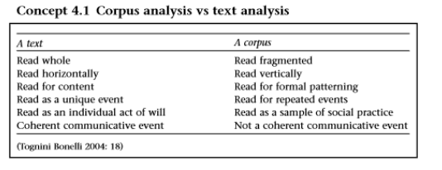
Although discourse analysis and corpus linguistics both make use of naturally occurring, attested data, they have intrinsically ontological and epistemological differences

Slide 23
Spoken corpora
Prosodic: corpus investigations which focus on the relationship between prosodic information (e.g. tone choices, stress, pauses) and discourse features.
Rhetorical: corpus investigations which focus on pragmatic devices such as hedges.

Slide 24
http://www.ucl.ac.uk/english-usage/projects/ice-gb/

