Slide 1
DICCIÓN INGLESA II
BUTT_USING FUNCTIONAL GRAMMAR

Slide 2
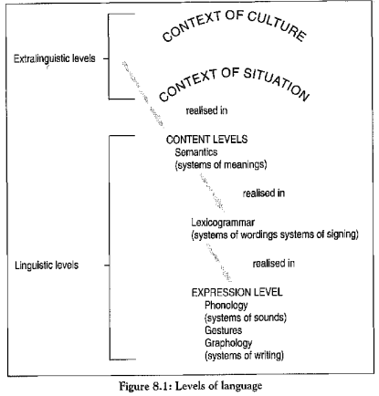
The relation between context and
meanings is dynamic and reversible,
with contexts being realised in
texts and texts revealing contexts.
Knowledge of the context alllows
us to make prefictions about the
lexicogrammar of a text.
Grammatical analysis allows us to
understand the context of a
text´s production
The sum of the meanings encoded
in the lexicogrammar becomes the
sign of the context

Slide 3
METALANGUAGE FOR EXPLORING THE RELATION BETWEN TEXT AND CONTEXT
The context of situation motivates the meanings of texts in three
Main areas
Field field of human experience- text purpose
Tenor social relationship between speaker/writer- addressee
Mode nature of the text – role language plays

Slide 4
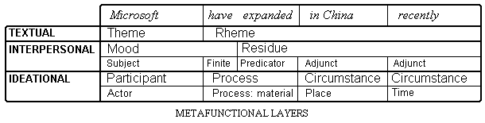
FIELD TENOR MODE
Ideational Interpersonal Textual

Slide 5
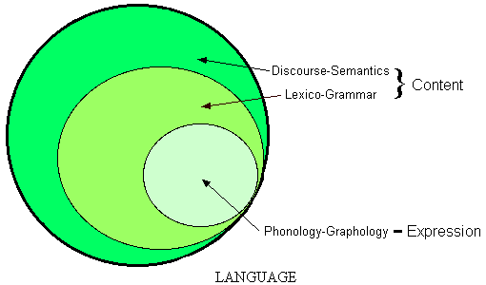

Slide 6
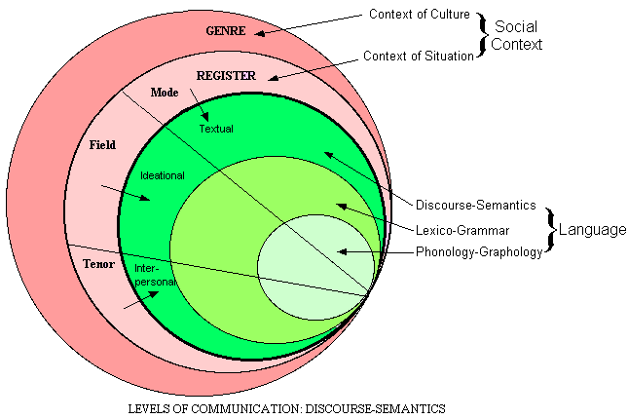

Slide 7
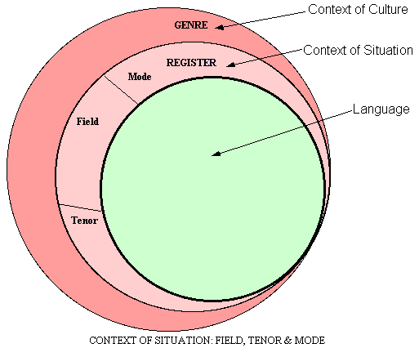

Slide 8
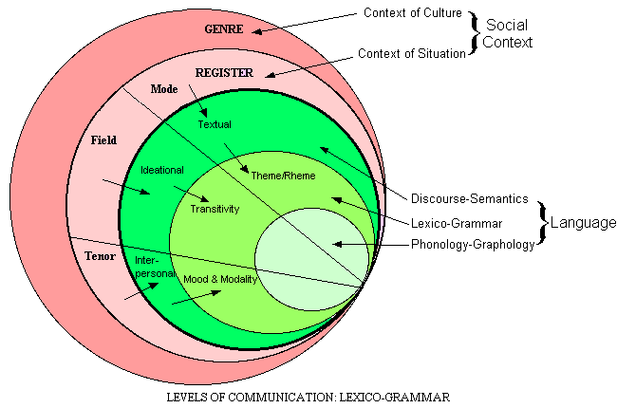

Slide 9
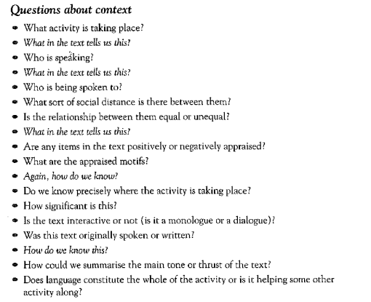
FIELD
TENOR
MODE

Slide 10
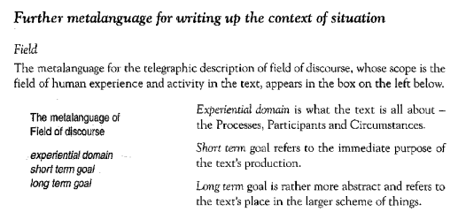

Slide 11
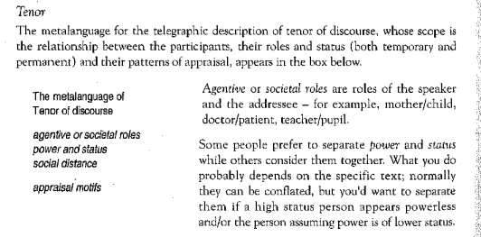

Slide 12
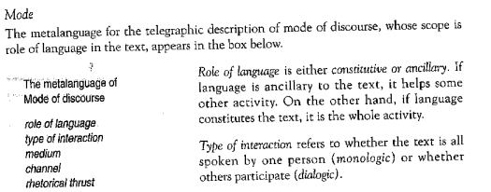

Slide 13
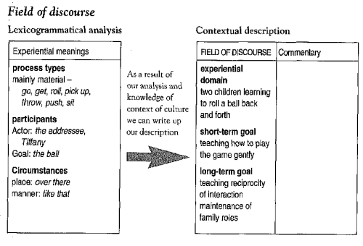

Slide 14
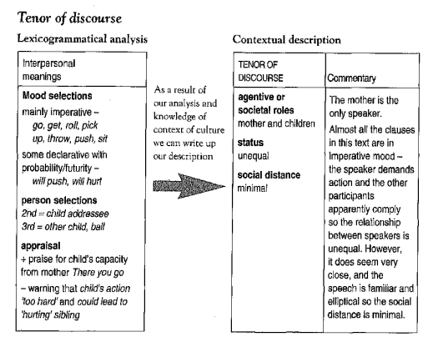

Slide 15
