Slide 1
GENRES IN CONVERSATION
Thornbury and Slade
Conversation from Description to Pedagogy

Slide 2



Slide 3



Slide 4
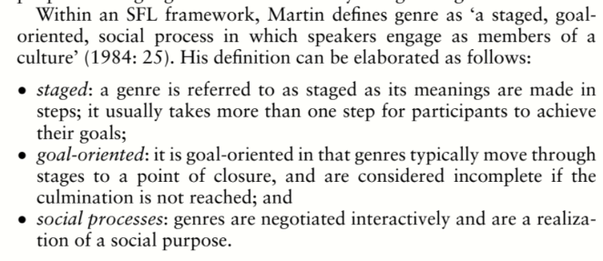


Slide 5
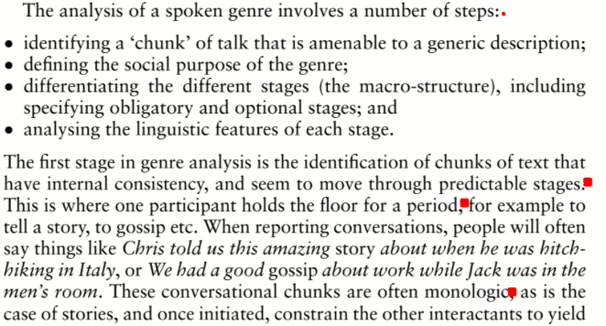


Slide 6
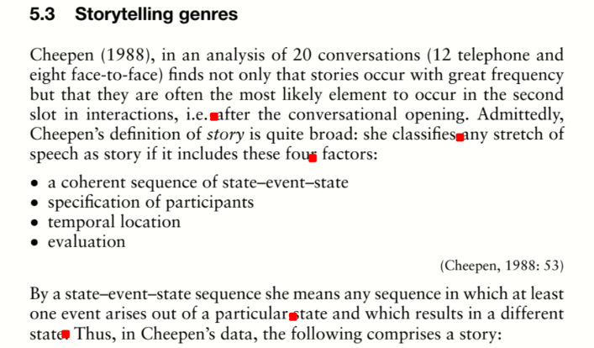

Slide 7
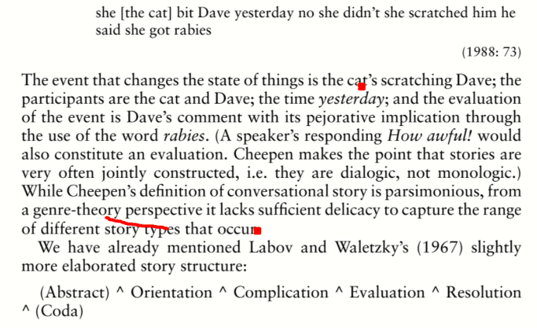

Slide 8


Slide 9
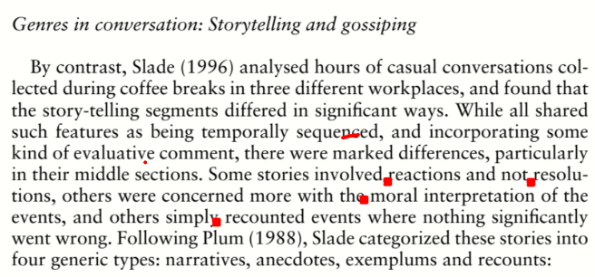

Slide 10
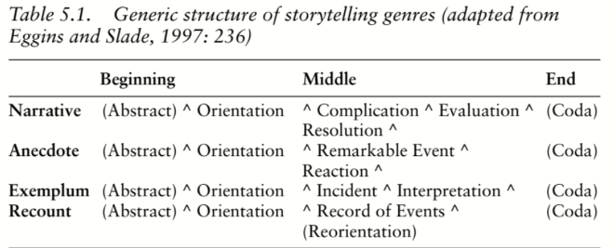

Slide 11
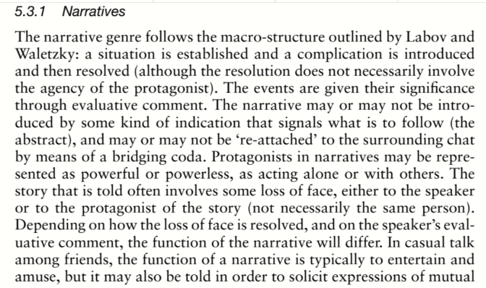

Slide 12


Slide 13
