Slide 1
Analysing conversation from butt’s perspective
By Maia Estein and Valentina Rodoni

Slide 2
Material situational setting
“The exact location of the discourse in time and space is known as material situational setting and […] we generally keep it quite separate from the more important contextual features which we have been calling the context of situation.
[…] What we are really interested in are the contextual features from the extralinguistic world that make the text what it is.”
Butt, (2003) p. 185-186

Slide 3
Field: lexicogrammatical analysis
Processes relational I was like…
material verbs of doing
projecting I think a lot of it is because…
Participants actors
carriers
tokens and value
Circumastances place
manner
I'll just kill them.
*CAM: Those naughty boys.
*CAM: I'll look at some of the houses
I'm like ooh
is it this one
is this one it
(.) and then I just-
*CAM: Oh no
that's the one.

Slide 4
Field: contextual description
Experiential domain
Short term goal
Long term goal

Slide 5
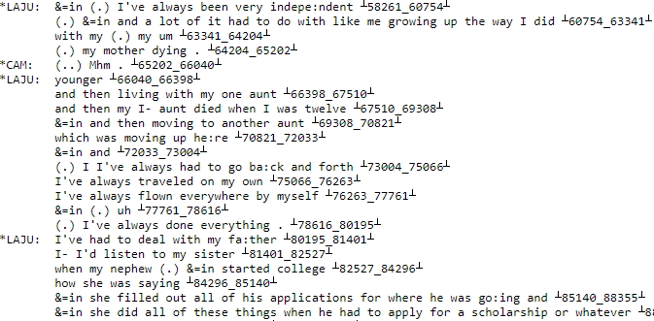
Mode: lexicogrammatical analysis
Thematic choices marked
unmarked
interpersonal
Cohesion
*LAJU: (.) Once you get ⌈2 to it ⌉.
*CAM: Oh no

Slide 6
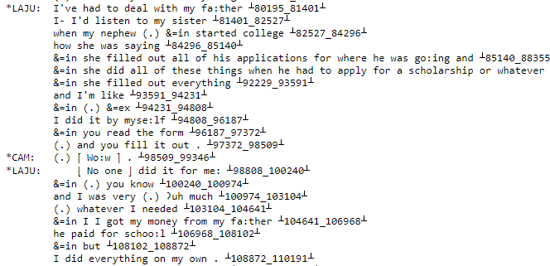
Mode: contextual description
Role of language constitutive
ancillary
Type of interaction monologic
dialogic

Slide 7
Medium spoken
written
Channel phonic
graphic
Rhetorical thrust

Slide 8
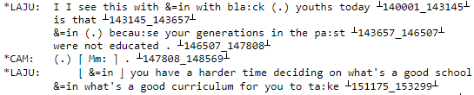

Tenor: lexicogrammatical analysis
I've always travelled on my own
I've always flown everywhere by myself
Mood selection declarative
imperative
Person selection
Appraisal positive
negative
&=in (.) you know
and I was very (.) ʔuh much
(.) whatever I needed
&=in I I got my money from my fa:ther
he paid for schoo:l
&=in but
I did everything on my own.

Slide 9
Tenor: contextual description
Societal roles
Status
Social distance

