Slide 1
Transcription

Slide 2
Jefferson, Gail. (2004) “Glossary of transcript symbols with an introduction”.
Transcribing in just something one does to prepare materials for analysis, theorizing, etc. Do the best you can, but what is there to talk about?

Slide 3
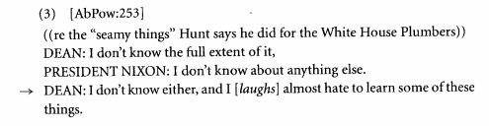
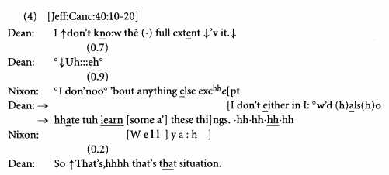
There might be something to talk about if we compare these two transcripts,

Slide 4
Why put all that stuff in?

Slide 5
Because it´s there and I think it´s interesting.

