Slide 1
PLOSIVES
Seminario de actualización disciplinaria de prácticas de pronunciación en Inglés 1
Secretaria de Extensión Universitaria- UNLP

Slide 2
Consonantal segments
Onset Medial Offset

Slide 3
1- Degree of stricture
Complete closure
Close approximation
Open approximation

Slide 4
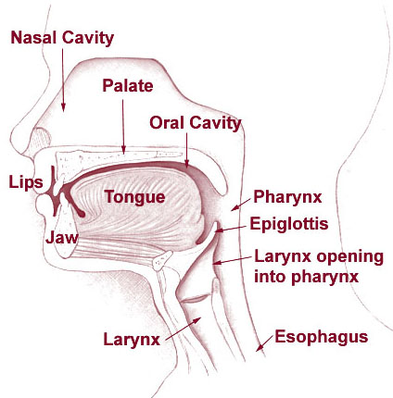
2- Place of articulation

Slide 5
Consonatal chart
 |  | Bilabial | Labio –dental | Dental | Alveolar | Palato- alveolar | Palatal | Velar
Complete closure | Plosive | p-b |  |  | t-d |  |  | k-g
 | Affricate
 | Nasal
Close approximation | Fricative
Open approximation | Approximant

Slide 6
English Plosives
Degree of stricture:
Complete closure
Place of articulation:
Bilabial- Alveolar- Velar
Voice:
Fortis- Lenis oposition

Slide 7
Spanish Plosives
1- Degree of stricture: /p-b/
El pato.. La capa
Está abierto
Está abajo
El hambre…
El tambo argentino
Bicicleta
Boca Jr

Slide 8
/ehta:Bierto/
/ehta:Baxo/
/elambre.../
/eltamboarxentino/
/bisikleta/ /Bisikleta/
/boka/ /Boka/

Slide 9
Spanish Plosives
1- Degree of stricture & place of articulation: /t-d/
“Todos los patos son altos.”
“Antes no era así…”
“Además…”
“Adiós”
“Andrés vive en una aldea”
“Dame dos.”
“Decime una cosa…”

Slide 10
1- Degree of stricture & place of articulation: /t-d/
/toDohlohpatos:onaltos/
antehnoerasi/
/aDemas/
/aDios/
/andrehBiBe:nuna:ldea/
/dameDos/ /DameDos/
/desimeunakosa/ /Desimeunakosa/

Slide 11
Spanish Plosives
1- Degree of stricture: /k-g/
“La casa de Paco”
“La gata de Águeda”
“¡Gustavo!”

Slide 12
1- Degree of stricture : /k-g/
/lakasaDepako/
/laGataDeaGeDa/
/guhtabo/ /GuhtaBo/

Slide 13
Problems…
Degree of stricture:
/b-B/
/d-D/
/g-G/
Place of articulation:
/t-d/
Voiced-voiceless:
Fortis- Lenis

Slide 14
Spanish & English Plosives
 |  | Bilabial | Dental | Alveolar | Velar
Complete closure | Plosive | p-b p-b | t-d | t-d | k-g k-g
Close Approxima- tion | Fricative | B | D |  | G

Slide 15
The baby put ten balls in the bag
The days of the week
Go away
Tom put ten toys in the box
Do it now

Slide 16
I do hope I’m not interrupting.
Mama, has sent me down to welcome you and to ask you to dine with us tonight.
Unless you’re too tired.
We would be delighted.
Good. Come at eight.
Won’t you stay and have some tea.
You’re far too busy.
I wouldn’t want to push in.

Slide 17
¡Muchas gracias!

