Slide 1
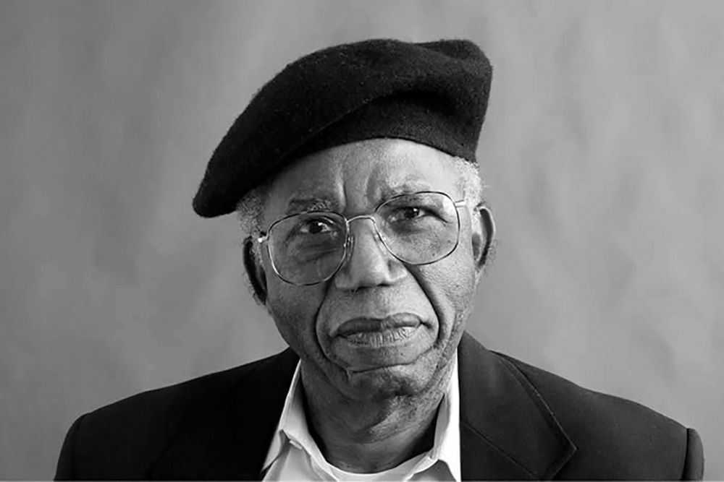
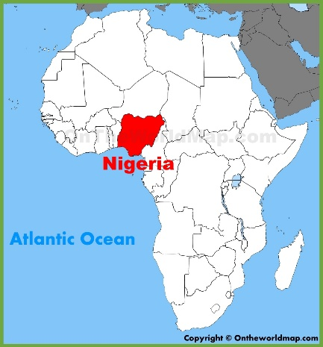
Chinua Achebe
Nigerian writer
Who did he write for?
What did he write about?
How do we know that his work was “groundbreaking”?

Slide 2


“I feel that the English language will be able to carry the weight of my African experience.... But it will have to be a new English, still in communion with its ancestral home but altered to suit its new African surroundings.” (p.56)
You want to establish some links between his biogtraphical notes (p.57) and this quote. You specifically wonder:
Why is he called the “patriarch of the African novel”?
Why does he need “a new English”?
How would English be altered?
Why “new” African surroundings?
In what sense would English have to be altered to “suit” his surroundings?
(p.58)

Slide 3
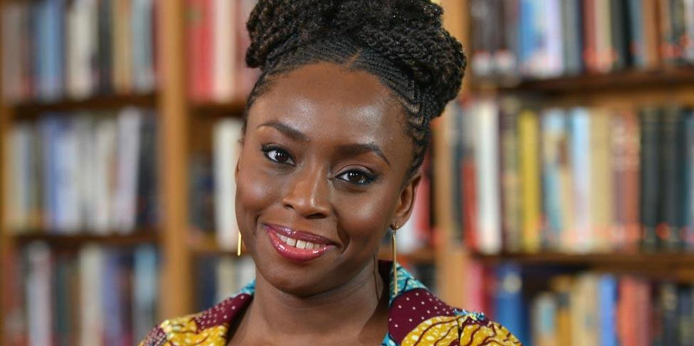

What connections are there between Chinua Achebe and Chimamanda Adichie?

Slide 4

The British stories Chimamanda read as a child determined the stories she wrote as a child. But she didn’t feel identified with these stories.
Why not?
Watch the video again and make notes to compare:
The stories she read and wrote
Her surroundings

Slide 5
SINGLE STORIES
Fide’s story
Her American roommate’s story
In what way(s) are these SINGLE STORIES?

Slide 6
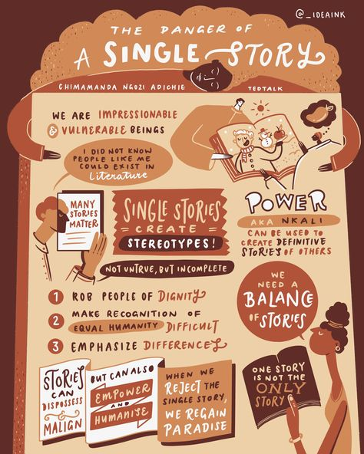
Chimamanda says that she’s guilty because she also believed in the single story of Mexicans:
What single story did he hear about Mexicans?
When and how did she realize it wasn’t truthful?
Who does she blame for having a single story of Mexico?

Slide 7
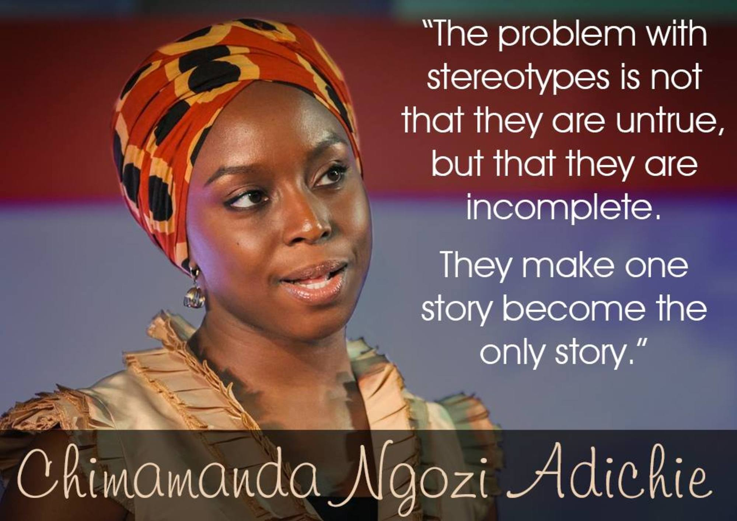
Which single stories have
you listened to?
Which stories have made
you who you are?

Slide 8
TRABAJO PRÁCTICO 3
You find a forum with the following thread and decide to participate.
These are the conditions for your post yo get published:
You should write between 50 and 80 words.
You must write ONE paragraph.
You can include a photo if you’d like to.
Find the the FORO in the tab corresponding for your TALLER.
Which stories have made us - Argentinians - who we are?

